Slide 1
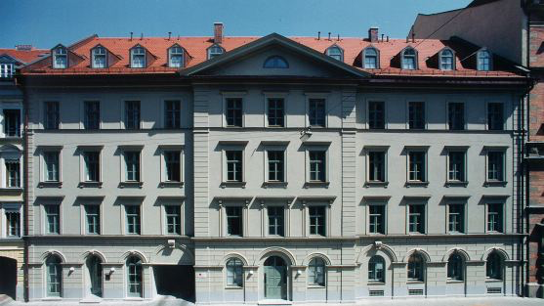
Welcome to the
Meeting on the Next Generation ⁷⁶Ge neutrinoless double beta Experiment
GERDA-MJD history and this meeting
Stefan Schönert
Chair for experimental physics and astroparticle physics
TU München
München, 25—27.4.2016

Slide 2
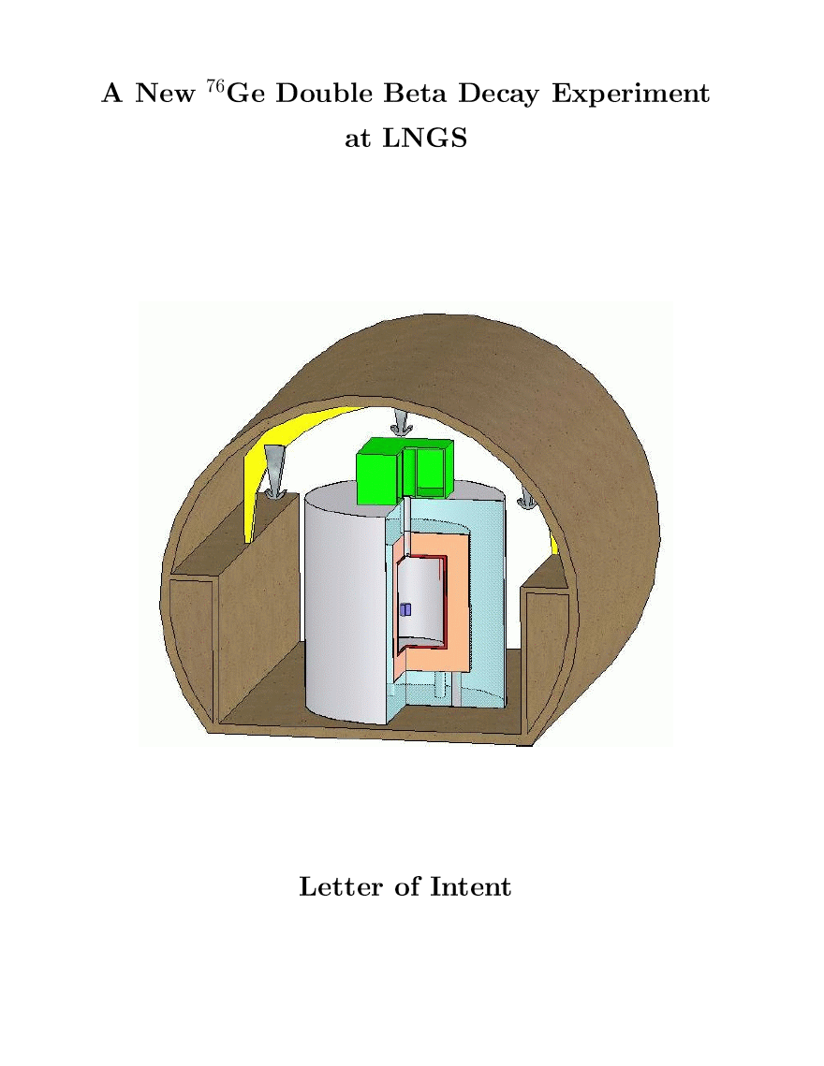
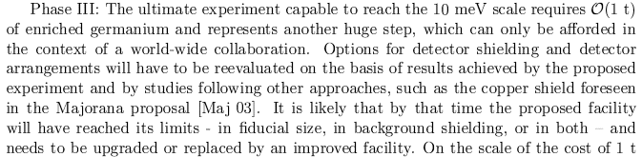
Letter of Intent (March, 2004) hep-ex/0404039
Proposal to LNGS (Sep 21, 2004)
Technical proposal (March 2005)
GERDA LOI:
“The experiment would proceed in several phases”
Phase I: 20 kg yr BI 10⁻² cts/(keV kg yr) => >10²⁵ yr
Phase II: : 100 kg yr BI 10⁻³ cts/(keV kg yr) => >10²⁶ yr

Slide 3
The GERDA-MAJORANA relation
GERDA and MAJORANA Letter of Intent (February 2005)
Addendum to LOI in 2008 (in context of S4)
MaGe simulation package; MGDO
sharing of information on the procurement of enriched Germanium and purification (respecting non-disclosure agreements)
crystal growth & underground storage
detector procurement
readout schemes
material screening results
…..
Members of the Majorana and GERDA collaborations routinely attend each other’s meetings to report on progress and to exchange information
Joint meetings once per year
NuSAG report 2005:

Slide 4

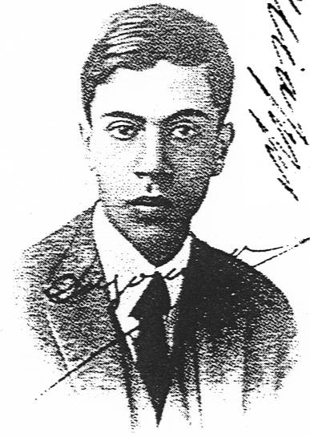
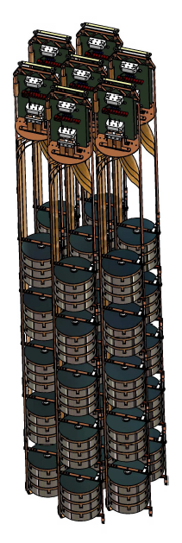

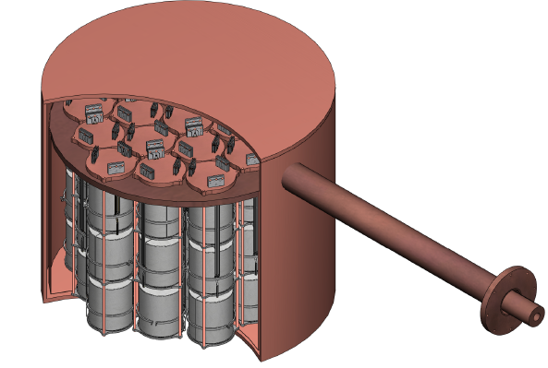

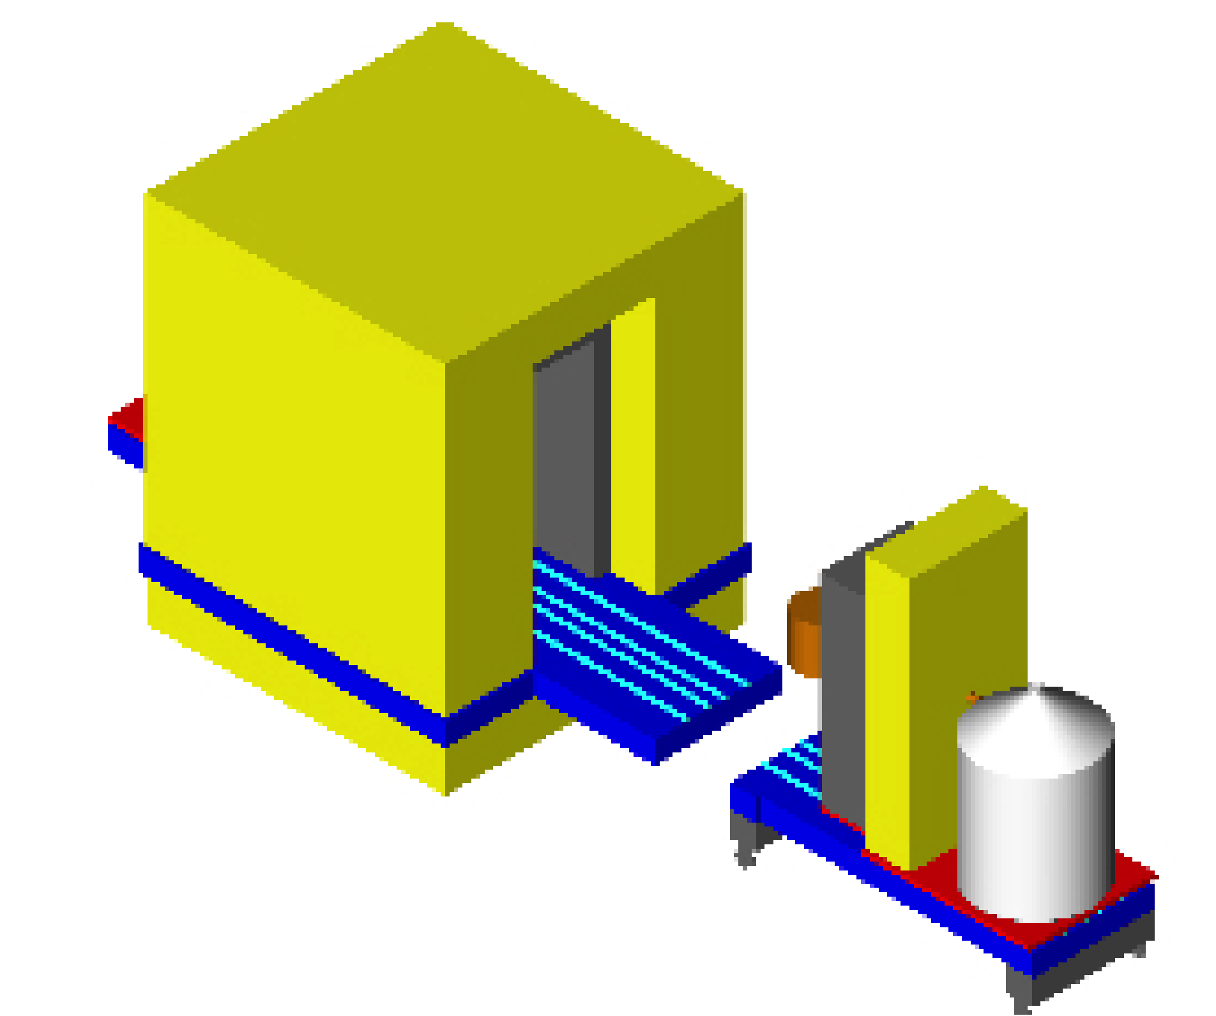






Two new ⁷⁶Ge Projects:
(Neutrino 2006 StS)
GERDA
Majorana
‘Bare’ ^{enr}Ge array in liquid argon (nitrogen)
Shield: high-purity liquid Argon (N) / H₂O
Phase I: ~18 kg (HdM/IGEX diodes)
Phase II: add ~20 kg new enr. Detectors; total ~40 kg
Array(s) of ^{enr}Ge housed in high-purity electroformed copper cryostat
Shield: electroformed copper / lead
Staged approach based on 60 kg arrays (60/120/180 kg)
Physics goals: degenerate mass range
Technology: study of bgds. and exp. techniques
LoI
open exchange of knowledge & technologies (e.g. MaGe MC)
consider to merge for O(1 ton) exp. ( inv. Hierarchy)

Slide 5

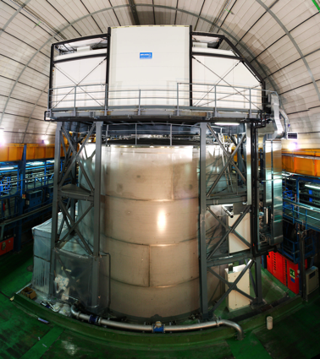
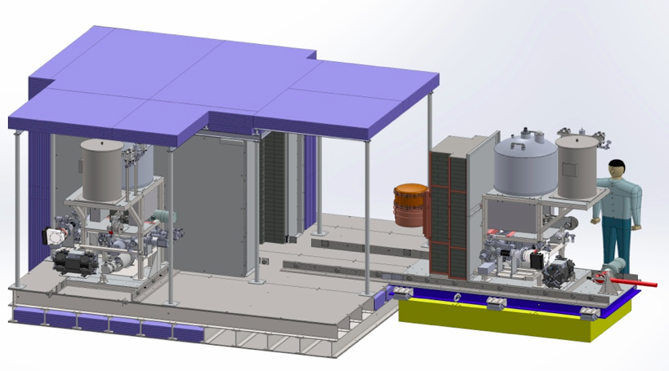
The ⁷⁶Ge-experiments: GERDA & Majorana-Demonstrator
GERDA
(NDM 2015, StS)
Majorana-Demonstrator (MJD)
Bare ^{enr}Ge array in liquid argon
Shield: high-purity liquid Argon / H₂O
Phase I: 17 kg (HdM/IGEX) - completed
Phase II: 38 kg enriched in ⁷⁶Ge
Array(s) of ^{enr}Ge housed in high-purity electroformed copper cryostat
Shield: electroformed copper / lead
30 kg enriched in ⁷⁶Ge
Physics goals: degenerate mass range
Technology: study of bgds. and exp. techniques
open exchange of knowledge & technologies (e.g. MaGe MC)
intention to merge for future large scale ⁷⁶Ge experiment selecting the best technologies tested in GERDA and Majorana
LoI
Also interests / discussion in China (Jin Ping)

Slide 6
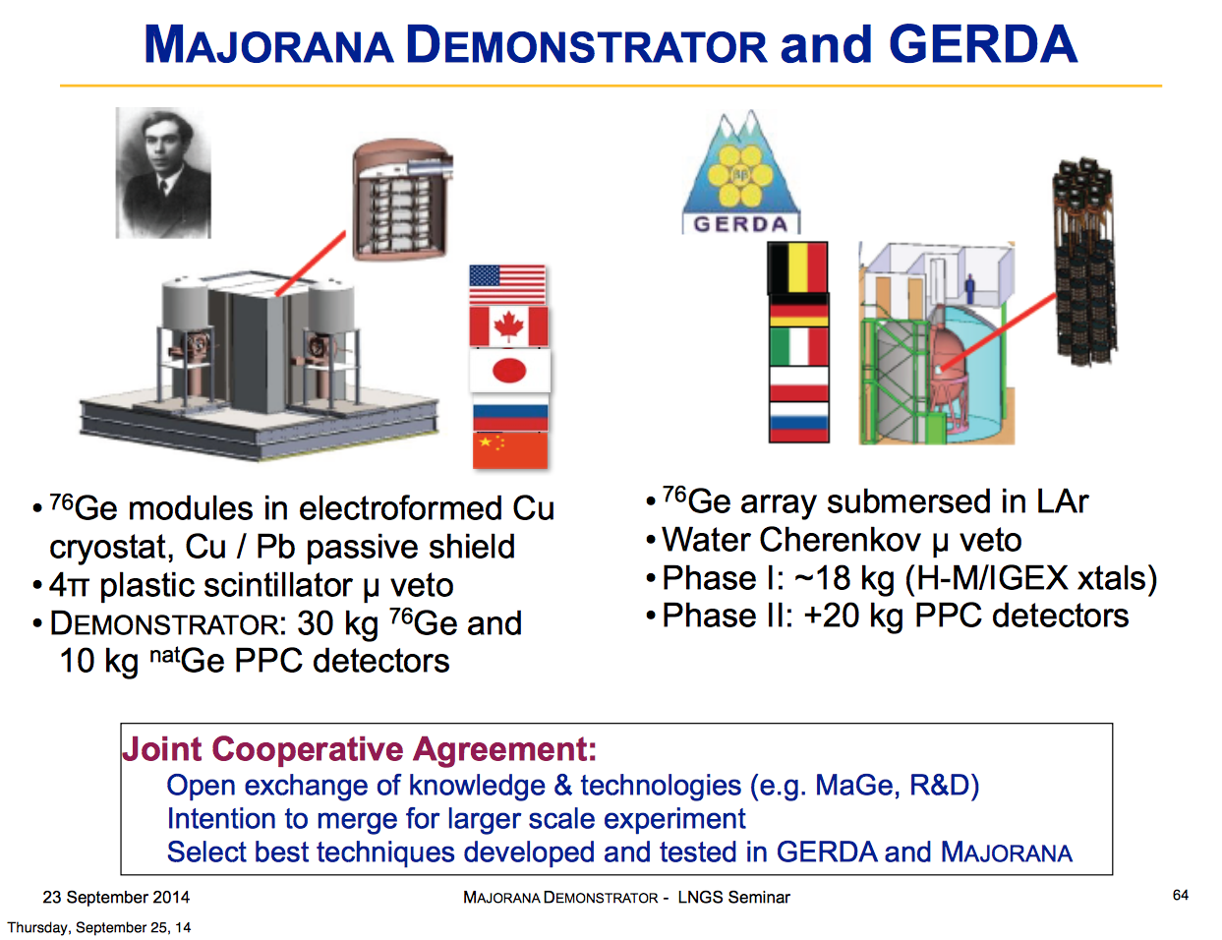
(LNGS 2014, JFW)

Slide 7
Where we are now….
Since end 2015 MJD and GERDA Phase II are taking physics data
GERDA and MJD backgrounds to be published at summer conferences
We are optimistic that we reach our background goals
Further background reduction needed for ton scale experiment
Time to start process to form world-wide-collaboration for NG-Ge76 experiment
Staging in several steps towards a ton scale experiment
Use of existing experimental infrastructures for first intermediate step
Experimental techniques advanced, but not yet ready…
Targeted R&D stimulated by MJD and GERDA experience
Opportunity for new groups

Slide 8
Goal of this workshop
Give overview about the status of MJD and GERDA Phase II
Review physics case for a large scale Ge76 double beta decay experiment
Understand that NG-Ge76 is neither GERDA nor MAJORANA, but a new collaborative effort
Collaboration development and governance discussion
Work out staging plans and converge towards the first intermediate phase
Preparation of R&D plan
Most important: attract new groups and start joint thinking!

