Slide 1
Radon and its Progeny A Pervasive Problem for Low Background Counting (with Lessons from Borexino and Biology)
Frank Calaprice
Princeton University

Slide 2
Solar Neutrinos with Borexino Milestones in Low-Background Counting
✓ ⁷Be 46.0 cpd/100t ± 5%. PRL 2011
⁸B (> 3 MeV) 0.22 cpd/100t ± 19% PRD 2010
pep 3.1 cpd/100t ± 22% PRL 2012
pp 144 cpd/100t ± 16% Nature 2014
Direct Measurement of Neutrinos in pp-chain
CNO limit: < 7.9 cpd/100t PRL 2012
?? CNO Low/Hi metallicity: 3 - 5 cpd/100t Underway…

Slide 3
Solar Neutrino Spectra
Neutrino Energy Spectrum
Neutrino-Electron Elastic Scattering Energy Spectrum
X2 for keV

Slide 4
Overview of the Borexino Detector (Lots of Active Shielding)
Shielding against external
backgrounds is very good.
Water: 2.25m
Buffer zones: 2.5 m
Outer scintillator zone: 1.25 m
Main backgrounds are in Liquid Scintillator.
¹⁴C/¹²C , ¹¹C (cosmogenic)
U, Th decay chain.
²²²Rn progeny (²¹⁰Pb, ²¹⁰Bi, ²¹⁰Po)
⁸⁵Kr
Pulse shape discrimination.
Alpha-beta separation is important

Slide 5
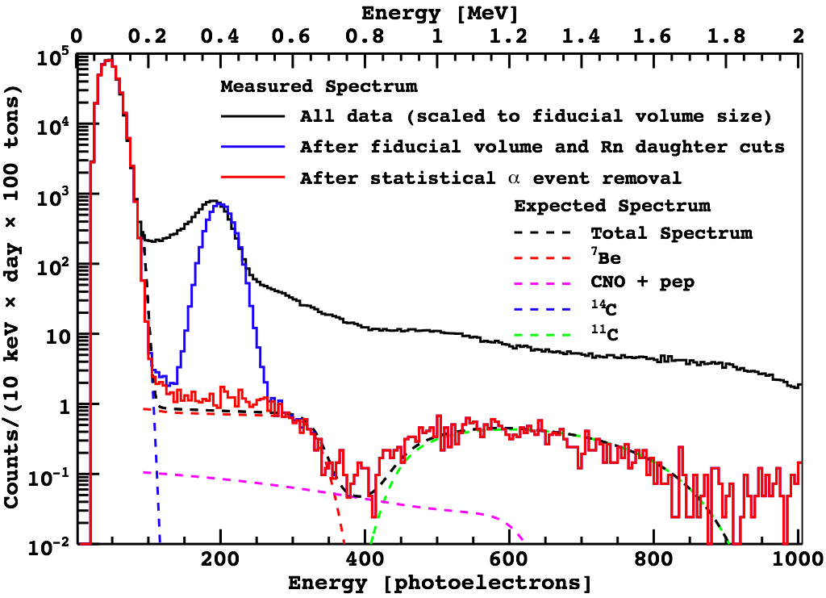
The ²¹⁰Po- ²¹⁰Pb(²¹⁰Bi) Mystery
2²¹⁰Po: ~8000 cpd/100t
2²¹⁰Bi+CNO: ~15 cpd/100t
²¹⁰Bi: ~10 CPD/100t]

Slide 6
The ²³⁸U and ²³²Th Decay Chains
Radon deposits ²¹⁰Pb (22 yr) which later contaminates scintillator with ²¹⁰Bi (1 MeV β) and ²¹⁰Po (5 MeV α).

Slide 7
The ²¹⁰Bi – ²¹⁰Po Puzzle of 2007
If ²¹⁰Bi and ²¹⁰Po come from ²¹⁰Pb in the scintillator, their rates should be similar.
The factor of ~800 difference was never understood.
New studies suggest a possible explanation that depends on radon progeny in water, and on biology.

Slide 8
Low-Background Scintillator Strategy
Built nylon vessel in first low-radon cleanroom.
Hermetically sealed class-100 cleanroom.
Vacuum swing charcoal filter developed to remove radon from make-up air.
“Precision cleaning” methods developed
Class-30 MIL-STD-1246C specification achieved for particulates in fluid handling system.
Developed scintillator purification systems
Distillation, water extraction , and nitrogen stripping.

Slide 9
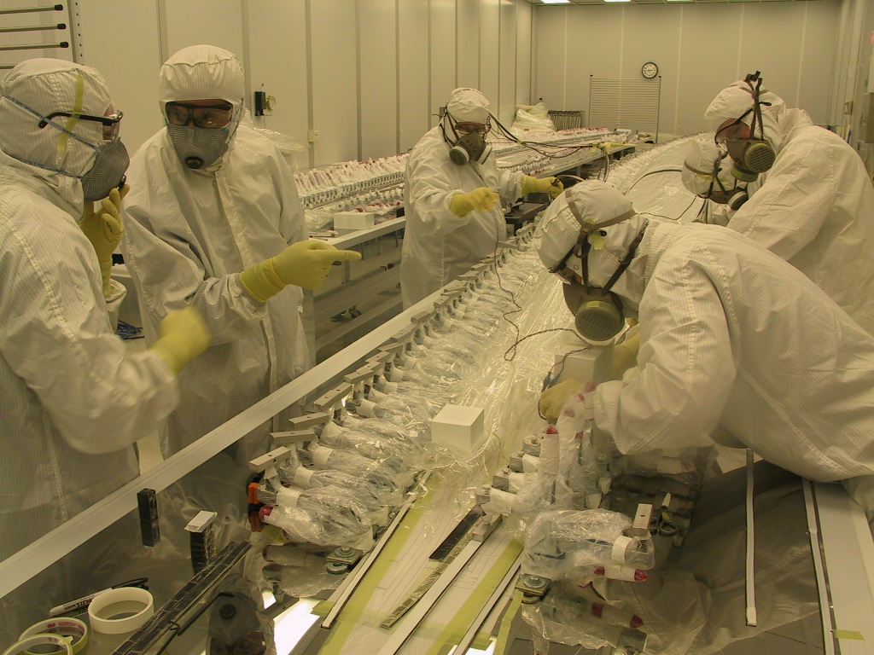
Nylon Scintillator Containment Vessel Fabricated in special Princeton Low-Radon Cleanroom
John Bahcall
First hermetically sealed
cleanroom with low-radon
air was developed to avoid
surface radioactivity due
to ²²²Rn daughters:
➔ ²¹⁰Pb (22 yr).
Fabrication time: > 1 yr
Low-radon cleanrooms
are now more common in
low-background research.

Slide 10
Purification of PPO-PC Master Solution
Water Extraction (not shown)
PPO-PC solution mixed with de-ionized water.
Scintillator and water separate.
Distillation of PPO-PC.
Falling film evaporator
N₂ stripping
Distillation and N2 stripping of PPO-PC
Water extraction was done to remove K in PPO.
New studies show it may have introduced ²¹⁰Po.

Slide 11
PC Distillation and N₂ Stripping and in-line Mixing of PPO-PC. (2007)

Slide 12
Initial Measurements (2007-2010)
Solar Neutrinos
⁷Be, ⁸B, pep
Geo-neutrinos
²³⁸U and ²³²Th anti-neutrinos
Search for Rare Processes
Solar axions, Pauli exclusion principle.

Slide 13
Re-Purification of Liquid Scintillator (2010-2011)
Reduce backgrounds by “loop”scintillator purification using:
“water extraction” and “nitrogen stripping”
First measurement of pp neutrinos, 2014
Enabled with lower ⁸⁵Kr and ²¹⁰Bi backgrounds.
Feasibility study for CNO neutrinos.
More reduction of ²¹⁰Bi needed.

Slide 14
Loop Re-Purification of Liquid Scintillator
“Loop” purification is achieved by draining fluid from bottom of vessel, passing it through purification system, and returning to the top.
Processes available are:
Water extraction or distillation
Nitrogen stripping (⁸⁵Kr)

Slide 15
Water Extraction and Nitrogen Stripping Performed 2010-2011
High purity water mixed with scintillator extracts impurities from the scintillator.
Water and scintillator separate.
Scintillator stays intact.
LNGS groundwater is first purified by reverse osmosis and ion-exchange in water plant.
Single stage evaporator used to distill and re-use water in “water extraction plant”.
10% of water is continuously wasted and replaced.
The water extraction system.
N₂ stripping column used in series

Slide 16
Results of 6 Cycles of Re-purification
Technical difficulties with 3 cycles; then 3 good cycles.
Impressive reductions of lower part of the ²³⁸U and ²³²Th chains.
Bi-Po’s less than 1 count/100t/year.
⁸⁵Kr reduced below detection limit.
²¹⁰Bi (²¹⁰Pb) modest reduction. Further reduction needed.
²¹⁰Po not reduced.

Slide 17
Studies of Radioactivity in Water
Poor removal of ²¹⁰Po triggered studies of radioactivity in the water.
LNGS ground water was known to have ²²²Rn at 10,000 Bq/m³.
New studies aimed at measuring Rn progeny: ²¹⁰Pb (²⁰⁸Pb), ²¹⁰Po.
Discovery #1- Nov 2012
De-ionization is much less effective in removing ²⁰⁸Pb and ²¹⁰Po from water compared to removing common impurities such as Mg.
Discovery #2 – April 2013 (Literature search by Brooke Russell)
Biological processes in micro-organisms in groundwater produce a volatile dimethyl polonium.
Dimethyl polonium has estimated boiling point of 138 C.
Removal of ²¹⁰Po from water, or from PPO-PC master solution, by single-stage distillation may not not be as effective as expected.

Slide 18
Purification of LNGS Groundwater Deionization is less effective for Pb and Po than for Mg.
²²²Rn in groundwater: ~10,000 Bq/m³
Notes:
This could explain a factor of ~100 between 201Pb and 210Po.
All that is needed is factor of 10 in biological background.

Slide 19
Biological Methylation of Po (Where Physics meets Biology)
Methylation
Enzymatic (catalytic) transfer of a methyl group from a donor atom to a receptor atom (e.g., ²¹⁰Po).
Biological Methylation (Biomethylation)
Methylation carried out by enzymes in biological systems, bacteria, fungi, etc.
Well established, with vast literature for stable elements.
Biomethylation occurs in chalcogens: O, S, Se, Te, Po.
Dimethyl polonium (CH₃)₂Po – Recent studies
Produced by micro-organisms in ground water.
Could be main form of Po in groundwater.
Not easily removed; Estimated boiling point: 138 C.

Slide 20
Test of Special Distillation to Remove Dimethyl-²¹⁰Po from Water.
Small-scale fractional distillation system tested at Princeton to remove ²¹⁰Po from groundwater.
6-foot tall column with structured packing and high reflux designed for x1000 reduction of 138 C impurity.
Princeton groundwater: x5 higher ²¹⁰Po than LNGS
²¹⁰Po in water measured by auto-deposition on silver foils and alpha particle counting.
Successful Results:
No ²¹⁰Po detected in product: reduction factor > 300.

Slide 21
Upgrade of Water Extraction System Previous & New Upgrade with 2 New Fractional Distillation Columns
Proposed
System
Present
System
Proposed
System
Current
System
Make-up water
system not shown.
Make-up water
system not shown.

Slide 22
Conclusions
Poor removal of ²¹⁰Pb and ²¹⁰Po in water purification process and bio-methylation of ²¹⁰Po have been identified as serious sources of background.
Can explain initial much higher ²¹⁰Po >> ²¹⁰Bi.
New distillation methods to improve water extraction have been identified and tested. Columns under construction.
Direct distillation of PC and PPO is also available.
Existing distillation column for PC
A new distillation column for PPO
Radioactivity in “purified groundwater” is problematic.
Use with care in other low-background experiments.
Prospects for CNO with Borexino look good.

Slide 23
The End

Slide 24
Spares

Slide 25
Element Biomethylation
John Thayer,
“Biological methylation of
less-studied elements.”
Applied Organometallic Chem.,
16, 677 (2002)
1: bacteria
2: fungi/algae/yeast
3: plants
4: animals

Slide 26
N₂ Stripping of ²¹⁰Po from Well Water

Slide 27
Volatility of ²¹⁰Po Spiked Bread Mold

Slide 28
²¹⁰Pb and ²¹⁰Po in the Environment
Radon in Outside Air (Bq/m³)
²²²Rn: ~10
²¹⁰Pb: 0.12 – 1.5
²¹⁰Po: 0.03 – 0.30
Radon progeny in Groundwater. Highly variable, depending on rock.
²¹⁰Pb (Bq/m³) ²¹⁰Po (Bq/m³)
1. Italian mineral water: 0.04 - 21
2. Finnish wells: 7-40 13 - 48
3. California wells: 3.7 -1400 0.25-550
4. Calif. health limits: 37 26
EU health limits: 200 100
Ref: Persson and Holm, J. Environ. Radioactivity, 102, 420 (2011)

