Slide 1
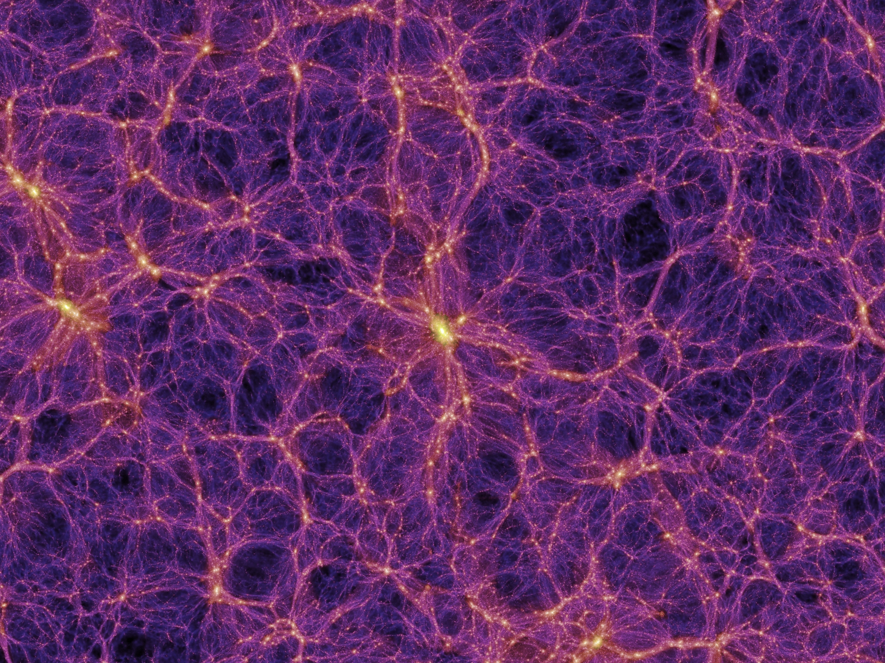
Reduction of Backgrounds for SuperCDMS
Ray Bunker — SDSM&T
for the SuperCDMS Collaboration
Image courtesy the Millennium Simulation—Springel et al., Nature 435 (2005) 629

Slide 2
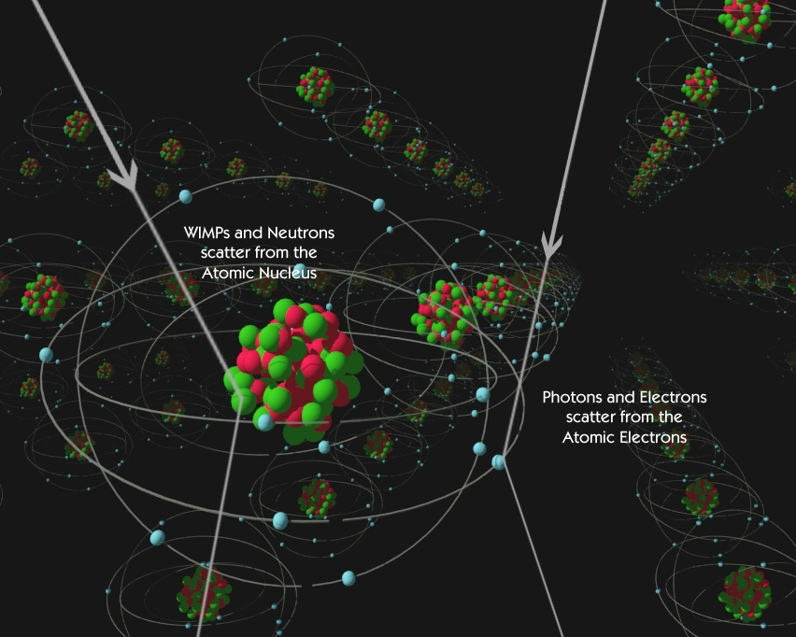
Neutral
Particle
Direct detection
Electrically
Charged
Particle
Slow Nuclear Recoil (NR)
deposits energy
over short distance
Fast Electron Recoil (ER) deposits energy
over large distance

Slide 3
CDMS technique — ionization & phonons
Inner & outer electrodes for
radial fiducialization away
from sidewall backgrounds
tungsten
Transition Edge Sensor (TES)
Quasiparticle
trap
Cooper pair
Aluminum
collector
holes⁺
Diffusion
e⁻
Ge or Si crystal
Ge or Si
Phonons
Nuclear
recoil (NR)
Electron
recoil (ER)
NR causes ≈20–30% ionization
relative to equal-energy ER
Phonons provide equal measure
of NR & ER recoil energies

Slide 4
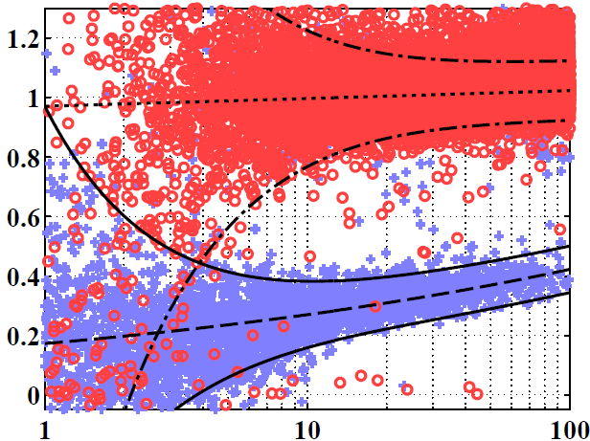
CDMS technique — ionization & phonons
Recoil energy
Extra energy:
Luke-phonon amplification → CDMSlite HV mode
γ-ray calibration ERs
Background at
low energy:
finite energy
resolution
Background at
high energy:
near-surface
electron recoils
Ionization Yield
Face events
Neutron calibration NRs
Sidewall events
Recoil Energy (keV)

Slide 5
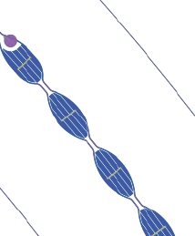
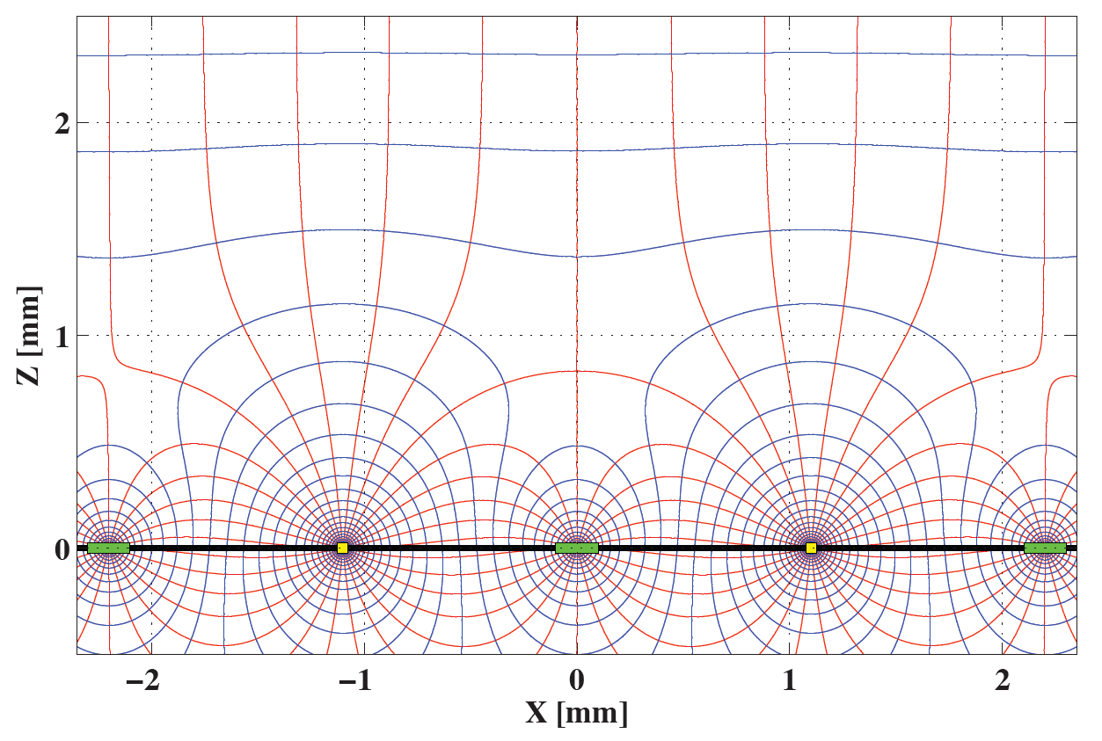
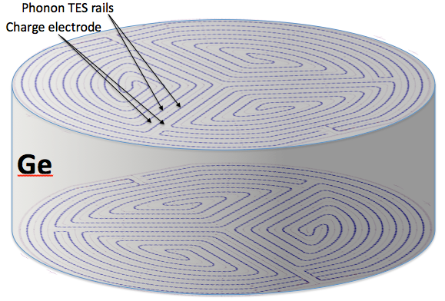
SuperCDMS technique — the iZIP
Interleaved ionization & phonon sensors
Phonon sensors @ 0V
Bulk event → Side-symmetric Ionization signal
Surface event → Asymmetric ionization signal
Ionization
electrodes @ ±2V
Significantly improved face-event rejection
Holes
Electrons
Holes
Electrons

Slide 6
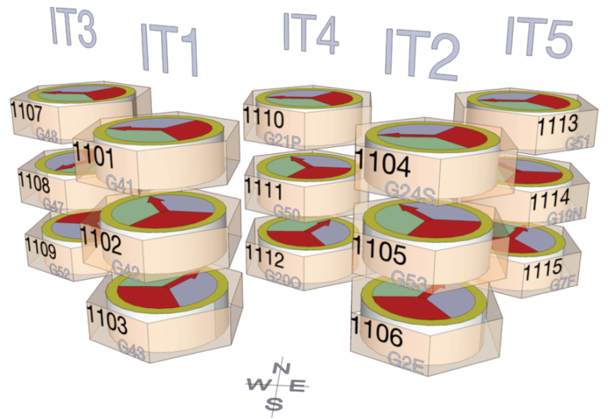
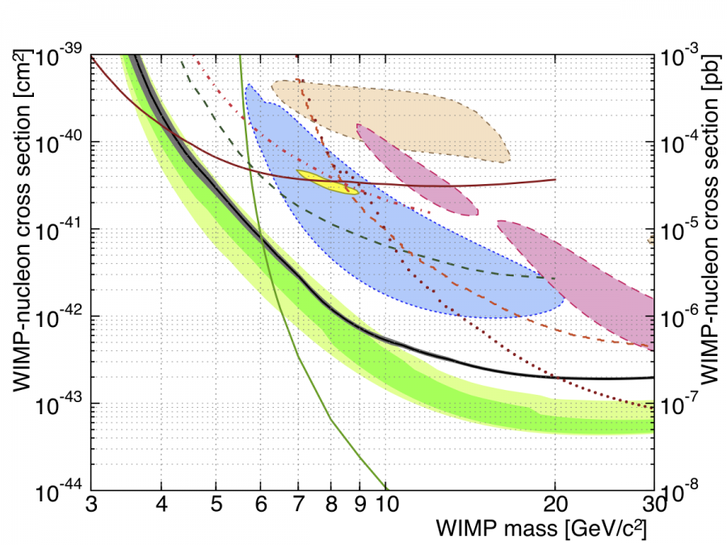
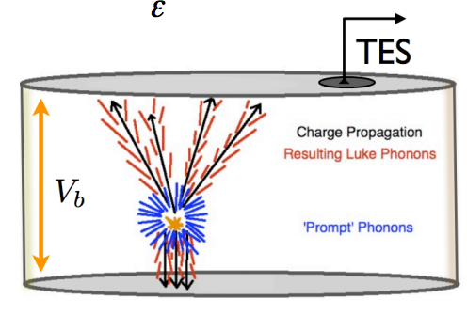
SuperCDMS Soudan
9 kg of Ge iZIPs using CDMS II Setup
3 iZIPs per tower, 0.6 kg each
Fully operational since early 2012
Primary science run ended summer 2014
3rd CDMSlite run through summer 2015
Tower 3
Sources
Low-mass Search Strategies
Ge is a relatively heavy nucleus
→ Go as low in threshold as possible
CDMSlite high-voltage mode:
Single detector: 5.9 kg days
Special bias configuration & readout
Extra-low threshold: < 1 keV_{nr}
Sacrifice standard ER discrimination
Low-threshold iZIP mode:
Seven detectors: 577 kg days
Low threshold: ≈1.6 keV_{nr}
Use improved iZIP discrimination
CDMSlite Run 1 — PRL 112 (2014) 041302
CDMS II Ge (LT)
DAMA/LIBRA
0 volts
Readout S1 phonons
1. CDMSlite
2. SuperCDMS
Soudan iZIP
Electron propagation
CDMS II Si
XENON10 S2
Luke phonons ∝ E-field
EDELWEISS (LT)
CRESST II
Primary recoil phonons
CDMS II Ge
LUX
Hole propagation
Stay tuned, analyses ongoing:
Full 3000 kg days in iZIP mode
2nd run of CDMSlite HV mode
≈ -70 volts
SuperCDMS Soudan iZIP — PRL 112 (2014) 241302 — Editor’s suggestion

Slide 7
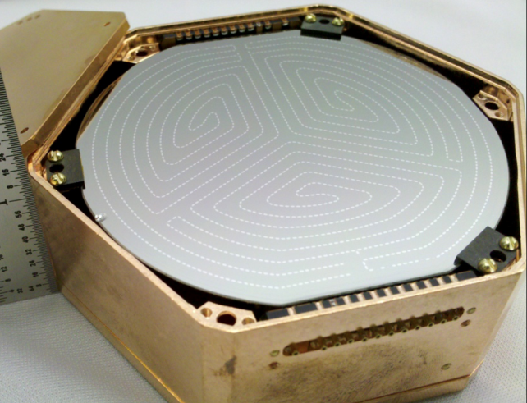
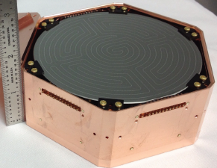
Next generation → SuperCDMS SNOLAB
Larger ≈50 kg target mass:
More & larger iZIPs
Cryostat large enough for 400 kg
Si & Ge crystals
Dedicated HV-mode tower:
→ also with Si & Ge
Lower background:
New facility at deeper site
Cleaner materials selection
Considering neutron veto
(see poster by Loer/Calkins)
Improved signal readout:
Phonons → new SQUID arrays
Ionization → switch to HEMTs
Improved tower design
Improved resolution:
σ_{phonon} ∝ T_{c}³ →lower operating temp
42 eV demonstrated (>4x better)
Improved cryogenics could give
>100x improvement!
SuperCDMS Soudan SuperCDMS SNOLAB
2.5 cm thick
3”diameter
600 g Ge
3.3 cm thick
4”diameter
1.4 kg Ge / 615 g Si
2 ionization + 2 ionization 6 phonon + 6 phonon
2 ionization + 2 ionization 4 phonon + 4 phonon
5 towers of 3 Ge iZIPs each
partial use of 1 iZIP in HV mode
8 towers with 6 detectors each:
7 towers = 36 Ge iZIPs + 6 Si iZIPs
Central tower = 4 Ge HV + 2 Si HV

Slide 8
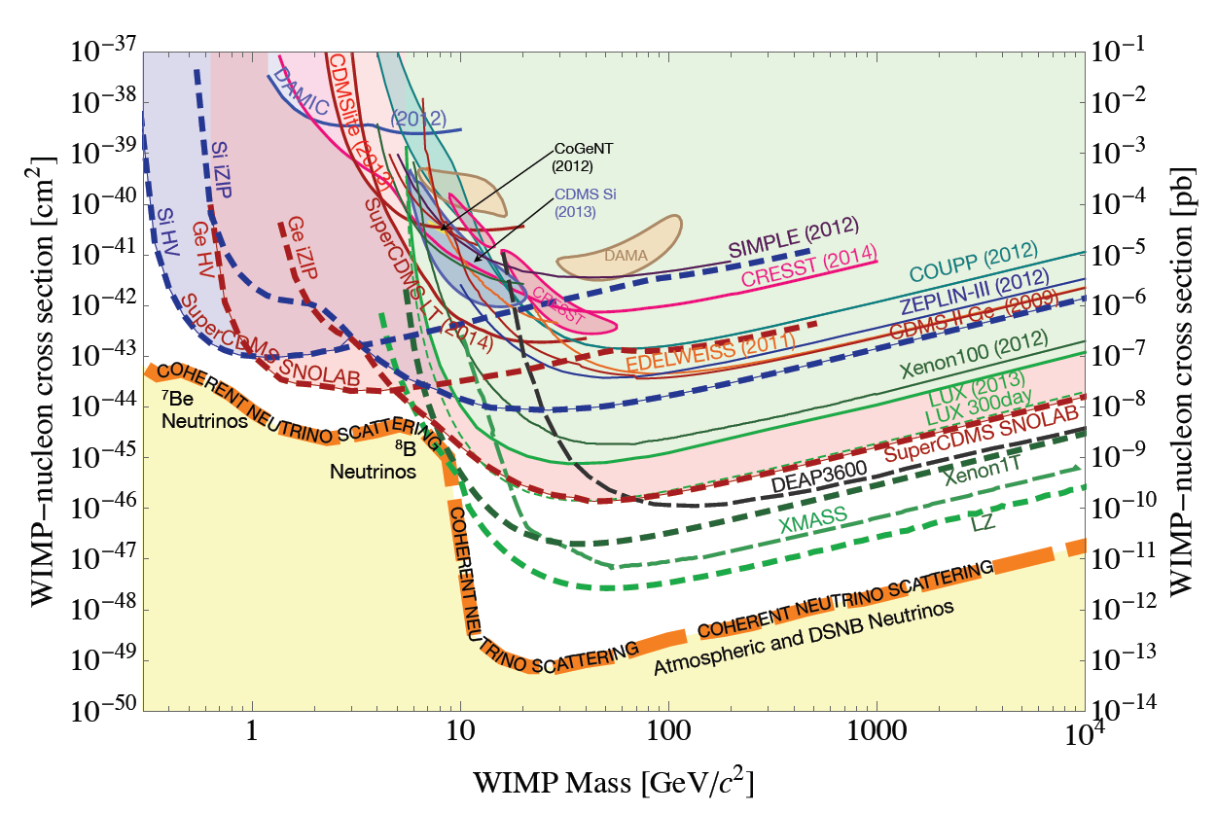
Projected Spin-Independent Sensitivities
Unique
low-mass
sensitivity
Detection of coherent
neutrino scattering

Slide 9
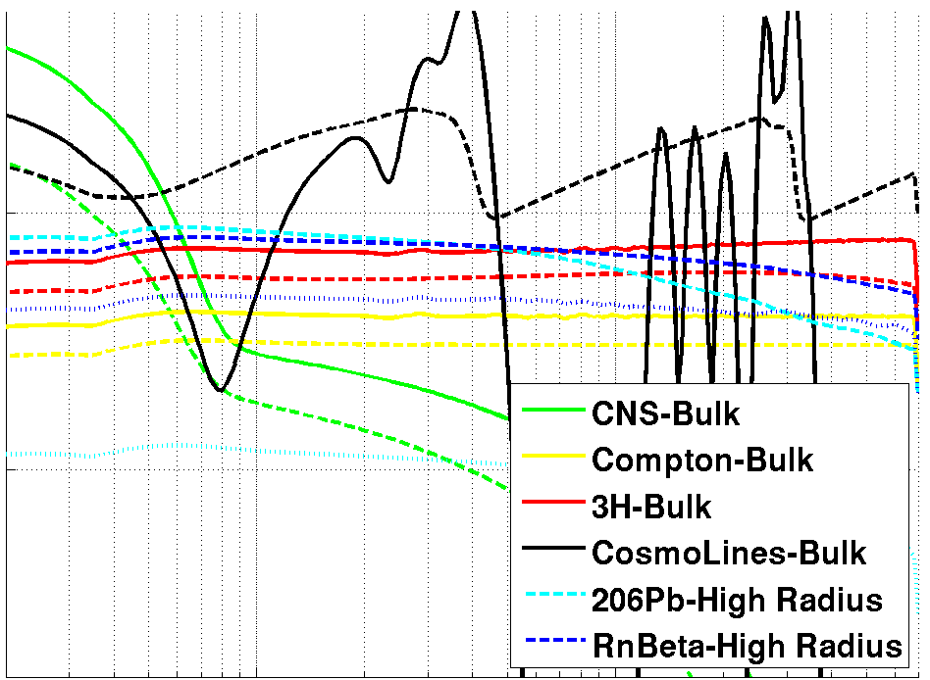
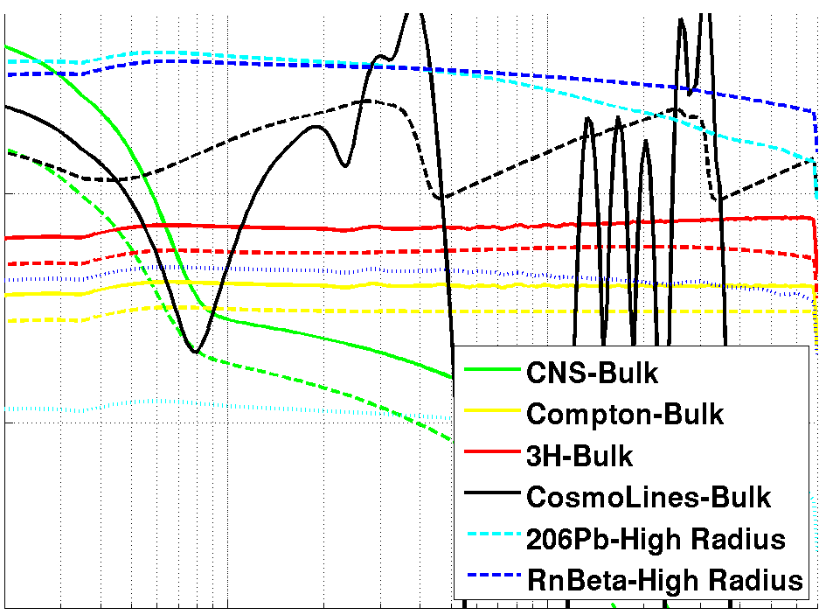
Background Reduction: Soudan → SNOLAB
Simulation of Soudan background levels
Reduce Intrinsic Backgrounds
Step 1 → Reduce photon background
(mainly) via radiopure copper:
220x lower than SuperCDMS Soudan
Based on levels achieved by
XENON100:
Cu → U/Th/K = 70/20/30 μBq/kg
Step 2 → Reduce radon-related background
near sidewalls via cleaner handling
& storage of copper housings:
Lower by 22x to 25 nBq/cm²
Same as level already achieved on
detector surfaces at Soudan
10⁰
Event rate [kg⁻¹ keVt⁻¹ yr⁻¹]
10⁻²
detector bulk
detector sidewall
detector face
1.0
10
Courtesy M. Pyle
Total phonon energy (keV)

Slide 10
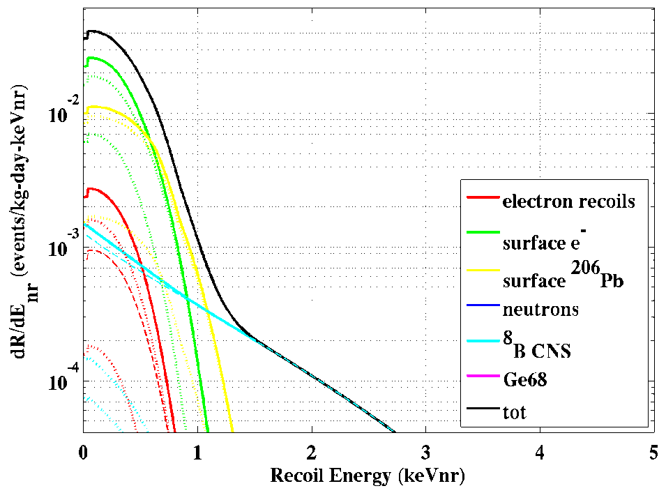
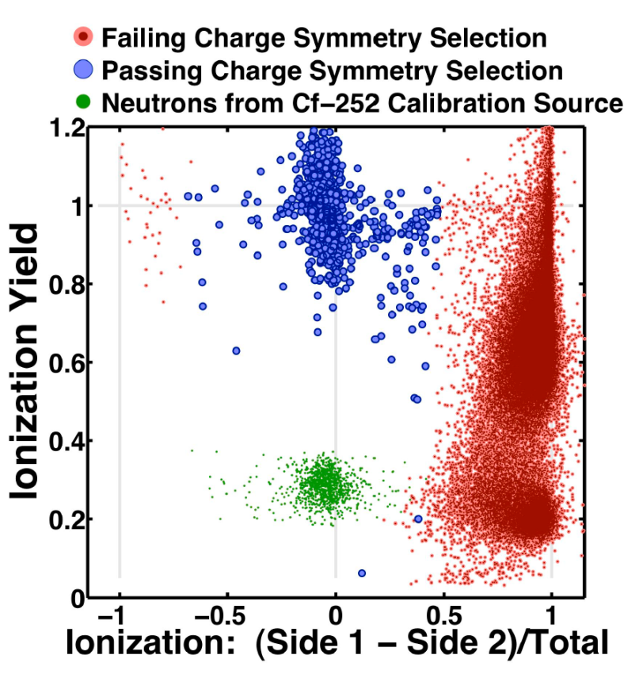
Further Reduction: iZIP Mode
Demonstrated background
rejection in iZIP mode
+
Improved ionization (100 eV) &
phonon (50 eV) resolutions
Expect to be free of ER backgrounds
for recoil energies >≈1.5 keVnr
For ≈200 kg-year Ge iZIP
exposure, expect handful
of solar neutrino events!
Surface Betas
Bulk ERs
Bulk NRs
²⁰⁶Pb Recoils
Discrimination breaks down
for lowest-energy recoils
due to finite resolution
Appl.Phys.Lett. 103 (2013) 164105
[arXiv:1305.2405]

Slide 11
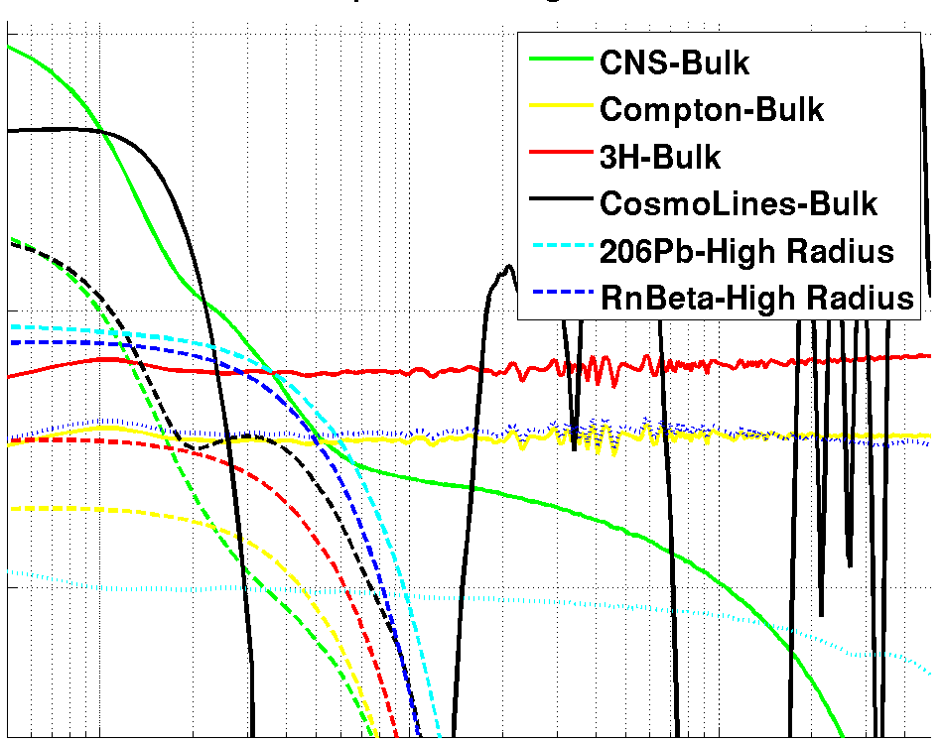
Further Reduction: HV Mode
Reduce intrinsic photon &
radon-related backgrounds
+
HV-mode detector improvements:
→ Increase from ≈70 to 100 V bias
→ Apply radial fiducialization
→ Improve phonon resolution to 50 eV
10⁰
10⁰
Event rate [kg⁻¹ keVt⁻¹ yr⁻¹]
Event rate [kg⁻¹ keVt⁻¹ yr⁻¹]
10⁻²
10⁻²
Courtesy M. Pyle
0.1
1.0
1.0
10
10
Total phonon energy (keV)
Total phonon energy (keV)

Slide 12
Background Reduction Summary
Reduce photon background:
Select radiopure shielding materials: lead, poly, copper
Reduce & prevent radon-related surface contamination:
Use established etching techniques to clean Ge, Si and Cu surfaces
Minimize exposure to radon through life of payload:
Nitrogen purge boxes for storage during fabrication and testing
Vacuum canisters for shipping
Radon-mitigated clean room underground at SNOLAB for payload installation
Detector improvements:
Upgraded electronics for improved ionization resolution
Lower T_{c} for improved phonon resolution
Larger bias voltage and use of radial fiducialization in HV mode

Slide 13
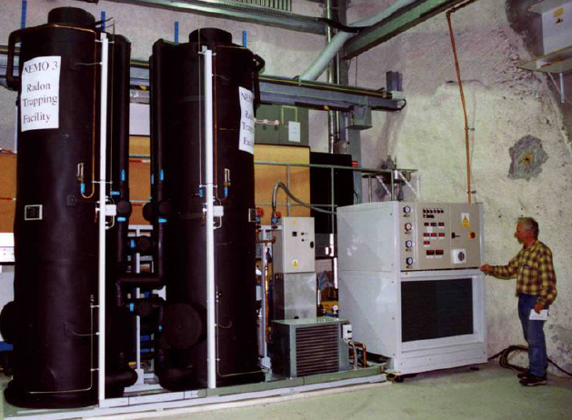
Carbon-based Radon Filters
Continuous flow:
Swing flow:
Most Rn decays before exiting carbon
C_{final} = C_{initial} exp[-t/t_{Rn}]
→ Assuming ideal column
Relatively simple & robust
Need to cool carbon to be effective
→ Ateko commercial system effective for NEMO
Stop gas flow well before breakthrough
Use at least 2 columns:
→ Regenerate column #1
→ Flow through column #2
C_{final} = 0
→ Assuming ideal column
More complicated
Vacuum-swing:
Potentially better performance than
continuous system at lower cost
A. Pocar, LRT2004 (Borexino)
Temperature-swing:
→ Expect best performance at highest cost
→ See poster by A. Hallin (& LRT2010)
breakthrough time
Rn lifetime

Slide 14
Vacuum-swing Adsorption (VSA)
Takes advantage of greater adsorption
capacity at high pressures:
Regenerate carbon by flowing small
fraction f of gas mass flow F back
through tank at low purge pressure
Volume purge flow φ_{purge}
Push back radon front if:
Syracuse system, f ≈ 10% with
P_{purge} ≈ 2.5 Torr → G ≈ 30 (ideally)
Input Air
F
Vacuum Pumps
Carbon
Column
#1
Carbon
Column
#2
P_{atm}
P_{purge}
f F
F
(1-f) F
Filtered output air

Slide 15
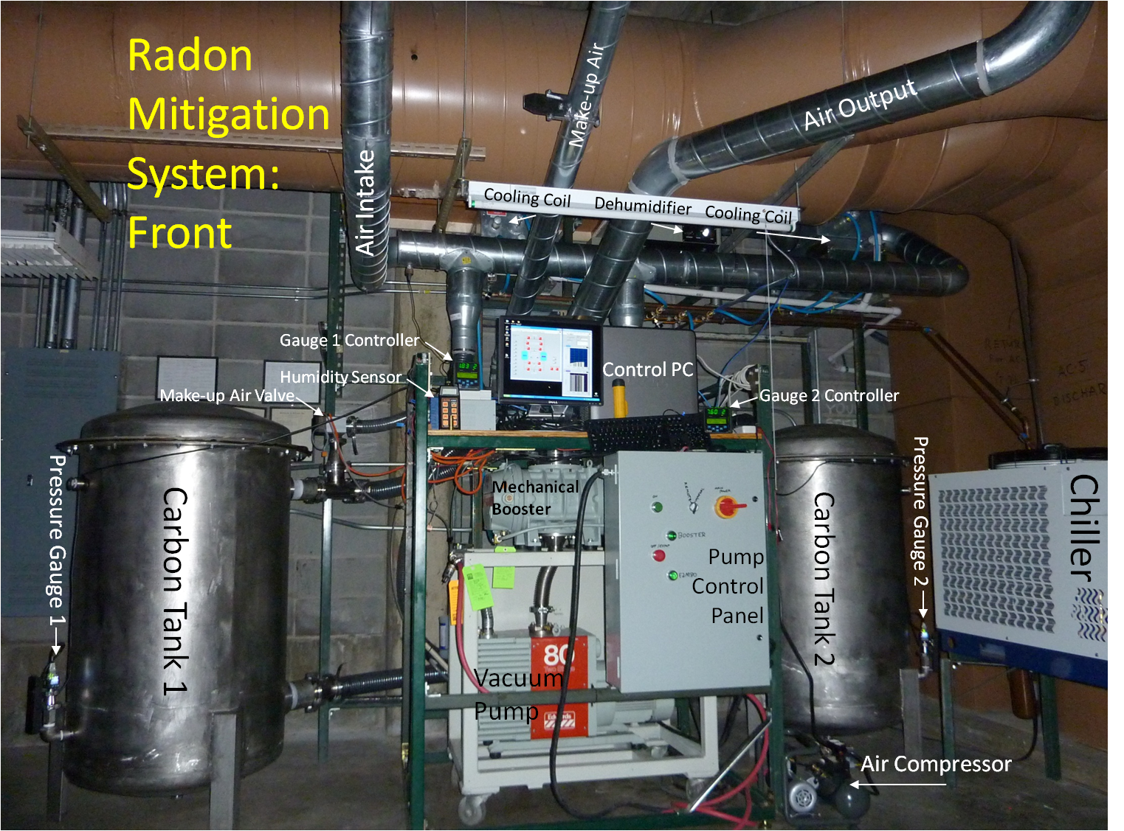
The Syracuse VSA
≈10 Bq/m³
≈0.1 Bq/m³

Slide 16
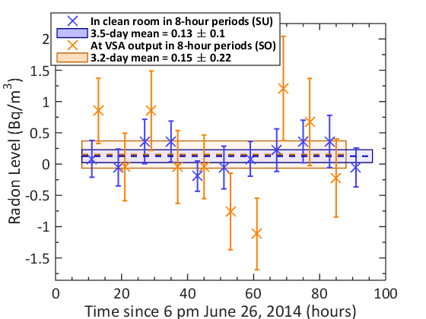
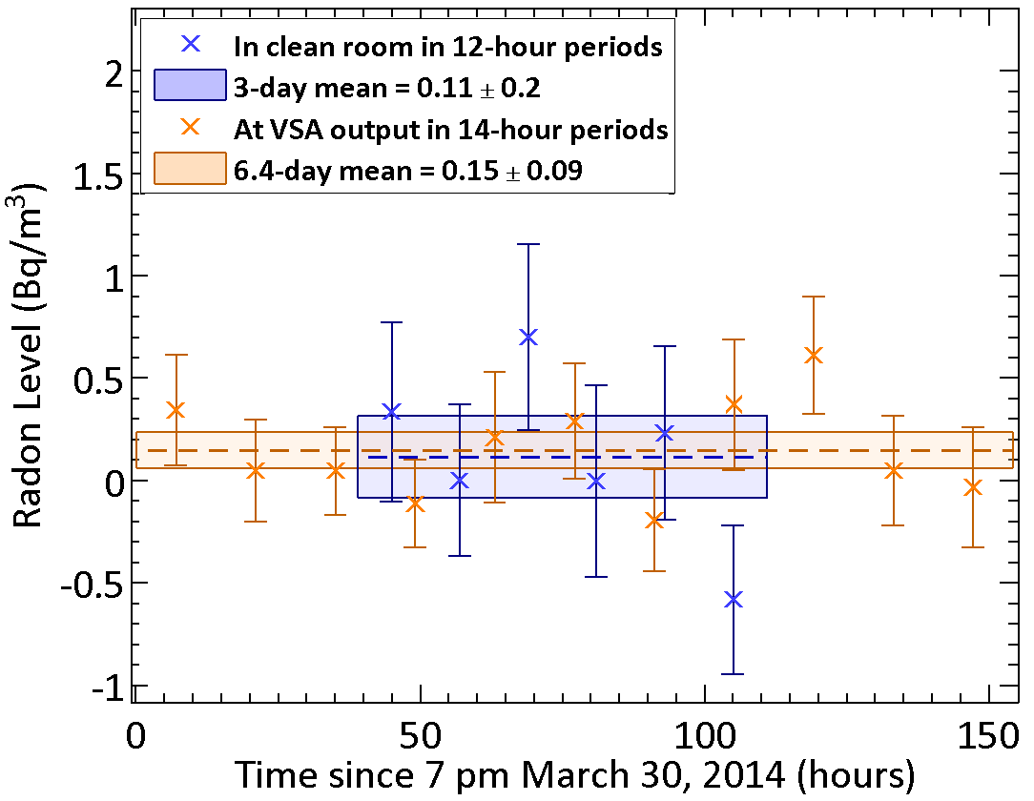
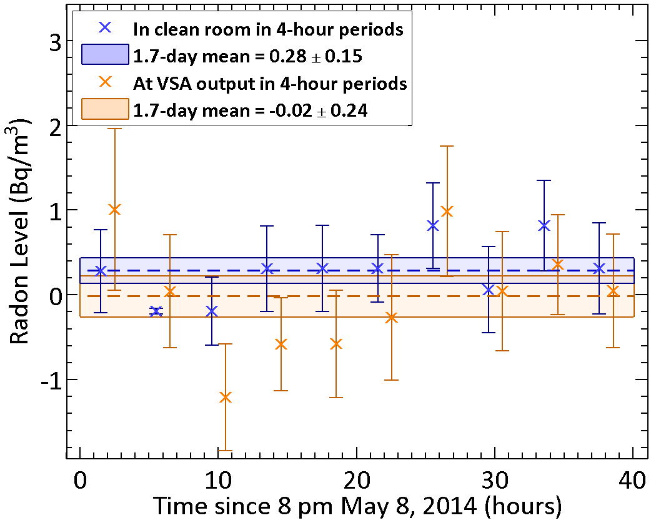
Syracuse VSA Performance
VSA now at SDSM&T with
several upgrades/improvements
see poster by Joseph Street
After ≈1.5 years of optimization and improvement of robustness:
Overcame difficulty of roughing pump to handle high humidity of upstate NY in summer
Identified & reduced leaks all along system (including clean room)
→ Ultimately limited by leaks in clean-room HVAC when HVAC circulation is on
Clean-room HVAC Off → >50x reduction
Clean-room HVAC On → ≈25x reduction
Final performance: <0.2 Bq/m³ (>40x reduction) in CR w/ HVAC on & 40 cfm of low-Rn air!

Slide 17
The SuperCDMS Collaboration

Slide 18
Backup Slides

Slide 19
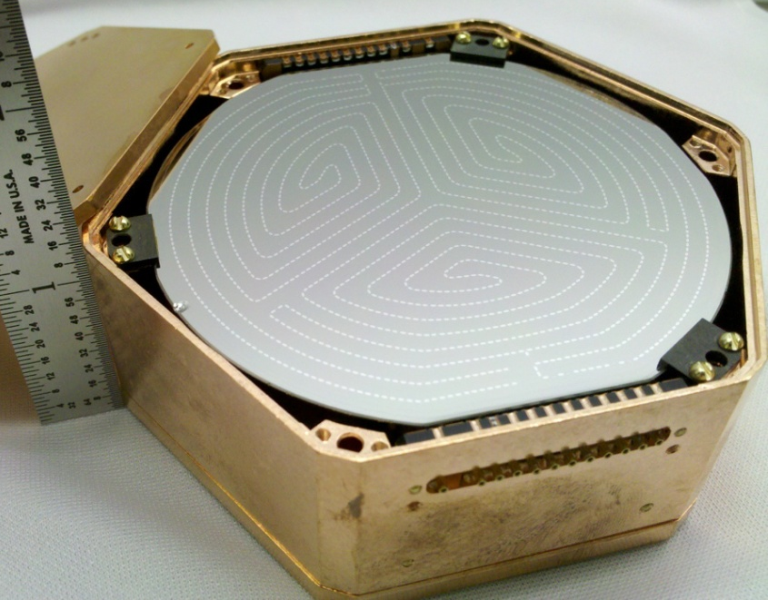
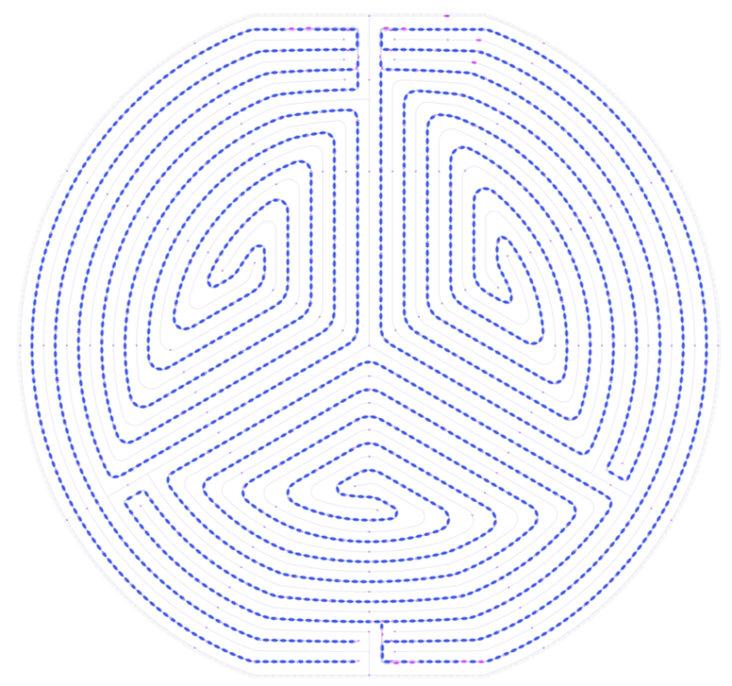
SuperCDMS iZIP
Top face @ +2V = Side 1 (S1)
Bottom face @ -2V = Side 2 (S2)
Detector upgrade to CDMS II
2.5x thicker → 600 gram Ge crystals with
interleaved phonon & ionization sensors
Doubled channel count:
Ionization Sensors (on both sides)
Inner & Outer-guard electrodes
Radial partitioning: Outer / (Inner + Outer)
z-direction partitioning: (S1 – S2) / (S1 + S2)
3D fiducialization with ionization signals alone
Near-perfect rejection of surface events for >8 keVr
Phonons Sensors (on both sides)
3 Inner channels + Outer-guard channel
Radial partitioning: Outer/(Outer + Σ Inner)
z-direction partitioning: (S1 – S2)/(S1 + S2)
Better signal to noise for lowest-energy triggers
→ Extend 3D fiducialization to low energy!

Slide 20
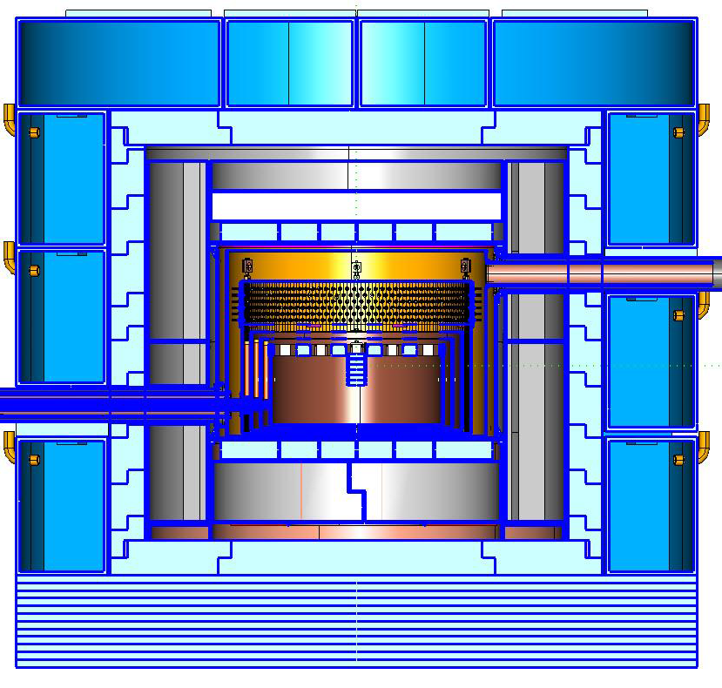
SuperCDMS SNOLAB shielding
Outer shielding (neutrons & gammas):
→ 60 cm water or polyethylene
Inner passive shielding (gammas):
→ 23 cm lead with radon purge
Electronics signals
Inner neutron shielding
(possibly active)
Cold finger
Detectors
Nested cryostat (gammas):
→1/2–3/8” low-activity copper
Assumed bulk contaminant levels no lower than measured
by other experiments for easily available radiopure materials

Slide 21
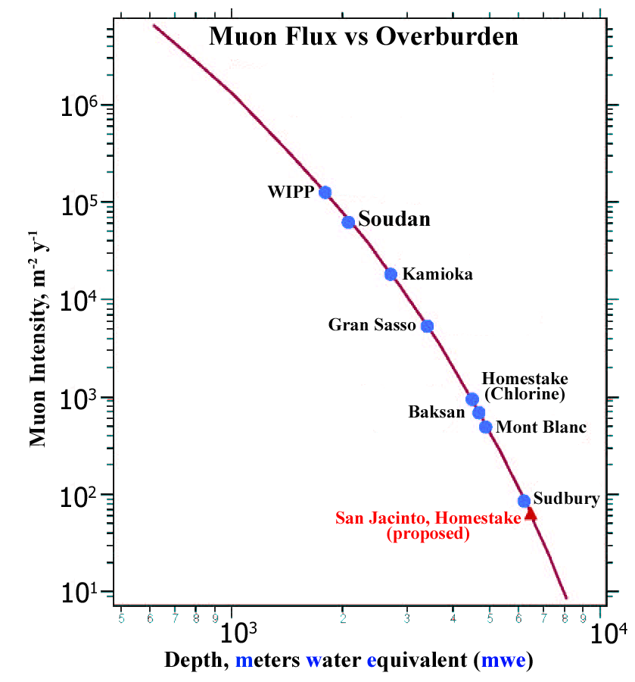
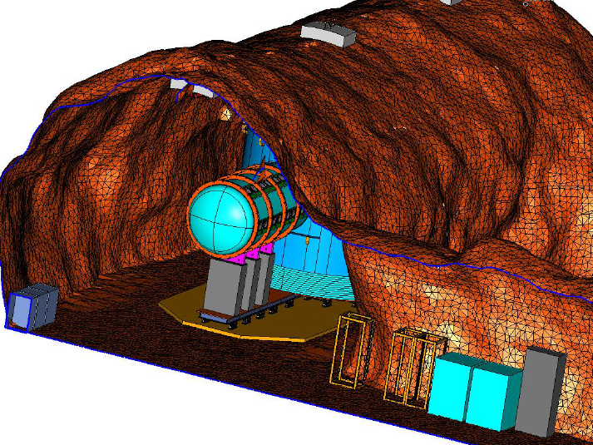
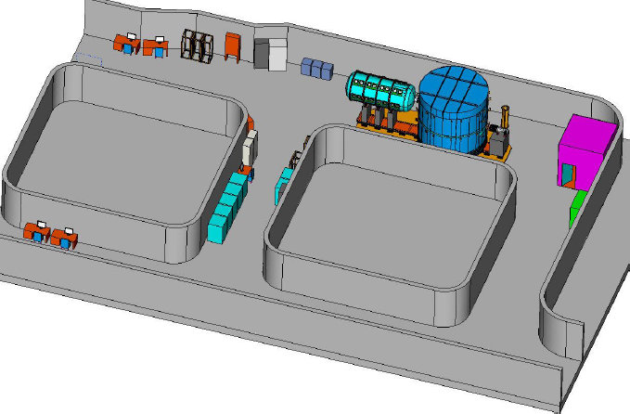
SuperCDMS SNOLAB ladder lab
μ flux down
by nearly 10³
Shielding
Electronics
Cryogenics

Slide 22
Detailed Breakdown of SNOLAB Backgrounds
Integrated or averaged from 8 to 48 keVnr
Assuming Ge target in iZIP mode with:
5 years of run time (80% live fraction)
50 (100) eV phonon (ionization) resolution
No neutron veto

Slide 23
Radon Exclusion Plans – SuperCDMS
Radon-mitigated clean room underground at SNOLAB:
Prevent exposure to 130 Bq/m³ Rn level underground during detector installation
14’ x 14’ x 8’ class 100 with 8’ x 8’ removal ceiling section for overhead crane access
Similar design elements to SDSM&T clean room:
→ Aluminum walls and thick polycarbonate (where needed) to limit radon diffusion
→ HVAC unit located inside clean room to prevent Syracuse issue
→ PTFE-based HEPA filters to help minimize radon emanation
→ Butyl rubber and Al-tape seals for leak tightness & to limit radon diffusion
Considering small anteroom with airlock for low-radon entry/exit of personnel
→ Alternative is to wait ≈hours to recover from Rn ingress during entry/exit
Need ≈50 cfm low-radon makeup air to overpressure clean room, considering:
→ Dedicated filter underground (similar to SDSM&T VSA); reduce to ≈0.1 Bq/m³ (or less)
→ Or use of existing compressed surface air (≈ few Bq/m³ and historically reliable)
→ Inform choice based on anticipated exposure integrated over full detector
history; need detailed radon-contamination model & specifications

Slide 24
Example Plate-out Calculation — SuperCDMS
Plate-out onto Detector Surface while in Purge Box at Test Facility
Assumptions:
activity in boil-off N₂, R_{Rn} = 500 μBq/m³
fraction of daughters that plate-out, f = 1 (conservative), or 1/85 (more likely?)
volume of box, V = 18”x18”x27” = 0.15 m³
storage duration, t_{exp} = 0.5 years (conservative), or 0.25 years (more likely)
Radon activity outside box, C = 30 Bq/m³
surface area of cabinet, A = 1.7 m²; thickness of acrylic, L = 0.25” = 0.635 cm
Acrylic diffusivity, D ≈ 10⁻¹¹ m²/s
²¹⁰Pb (and daughters) activity from boil-off plate-out:
R₂₁₀ = R_{Rn} x f x V x t_{exp} / τ₂₁₀
= 500 μBq/m³ x 1 x 0.15 m³ x 0.5 yr / 31.7 yr ≈ 1 μBq = 0.1 decays/day (conservative)
= 500 μBq/m³ x (1/85) x 0.15 m³ x 0.25 yr / 31.7 yr ≈ 10 nBq = 0.001 decays/day (more likely)
²¹⁰Pb (and daughters) activity from diffusion:
R_{Rn} = D x A x C x τ_{Rn} / L / V
= 10⁻¹¹ m²/s x 1.7 m² x 30 Bq/m³ x 5.5 d / 0.635 cm / V ≈ 40 mBq / V = 250 mBq/m³
R₂₁₀ = (R_{Rn} x f x V x t_{exp} / τ₂₁₀) x (air exchange rate / τ_{Rn}) = (5–500 μBq) x (1 hr / 5.5 d) ≈ 0.04–4 μBq
²¹⁰Pb (and daughters) from emanation:
Emanation from acrylic negligible; Most likely culprit is O-ring → ≈2 m length x 1 cm circumference
Assume O-ring is Viton = 80 mBq/m² → R_{Rn} = 80 mBq/m² x 2 m x 1 cm / V =1.6 mBq / V ≈ 11 mBq/m³
R₂₁₀ = (R_{Rn} x f x V x t_{exp} / τ₂₁₀) x (air exchange rate / τ_{Rn}) = (0.22–22 μBq) x (1 hr / 5.5 d) ≈ 0.002–0.2 μBq
Compare to surface specification of 25 nBq/cm² for 157 cm² detector faces → 4 μBq
fractional surface area

Slide 25
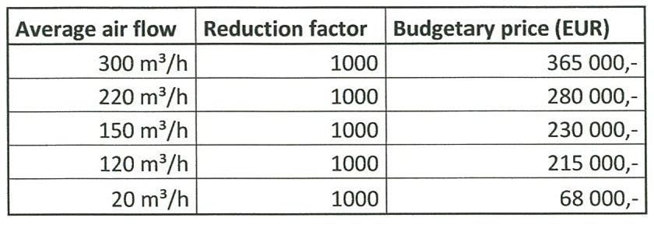
Carbon-based Filters — Price Comparison
Continuous
system
commercially
available from
Ateko
Syracuse
Vacuum-swing
90 m³/h | >40 | 40 000,-
Hardware only
What performance is needed?
Depends on leak/emanation rates in clean room and ultimate
concentration needed

Slide 26
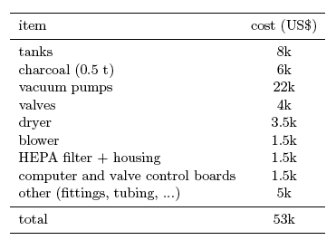
VSA Cost Breakdown
Based closely on Princeton design for Borexino (described well in Pocar thesis, and thanks to T. Shutt, A. Hallin, A. Pocar for discussions)
J. Collar
SU cost SDSMT added
(10 years later) cost (now)
2002 Princeton
9k 19k
1.5k 3.3k
10k 10k
7k
7.5k
(none) 0.7k
1k 0.4k
6k including gauges
5k + 8k chiller 3k (later)
55k + 36k
(0.3 t) (0.8 t)
no radon source
$8k pylon radon source

Slide 27
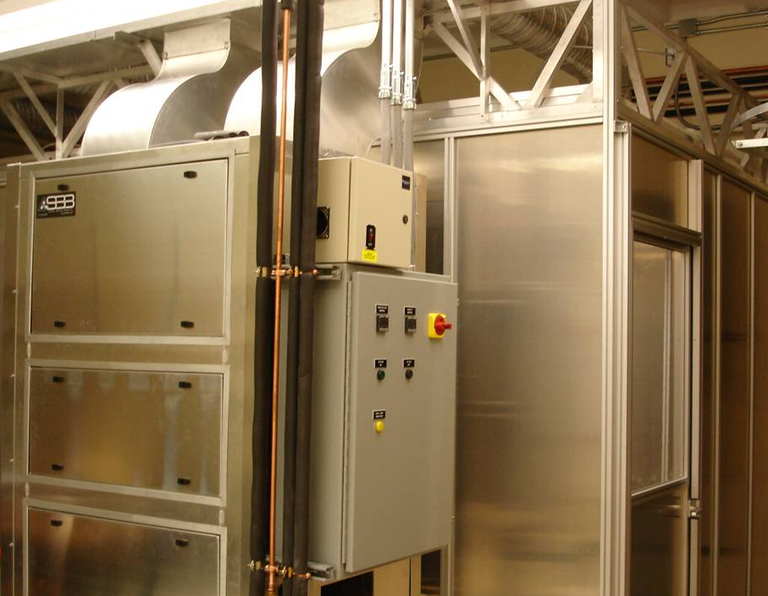
VSA Example – Syracuse Clean Room
All aluminum panels/extrusions with thick polycarbonate windows:
→ Minimize radon emanation & permeation
→ Very leak tight via butyl-rubber seals and butyl-backed Al foil tape
Designed for 30 cfm low-radon makeup air … ultimately used 30 to 50 cfm
8’ x 12’ x 8’ high with 4’ x 8’ anteroom
→ as small as would be practical
HVAC external to clean room:
→ For heating, cooling, humidifying
& recirculating CR air
→ Efforts to make leak tight, but
ultimate limiting factor
Aged water for humidification
Fast HEPA filtration:
→ ~1000 cfm recirculation
→ ~1 air exchange per 30 seconds
→ Trap daughters preferentially
in HEPA filters … up to 10x lower
even before Rn mitigation

Slide 28
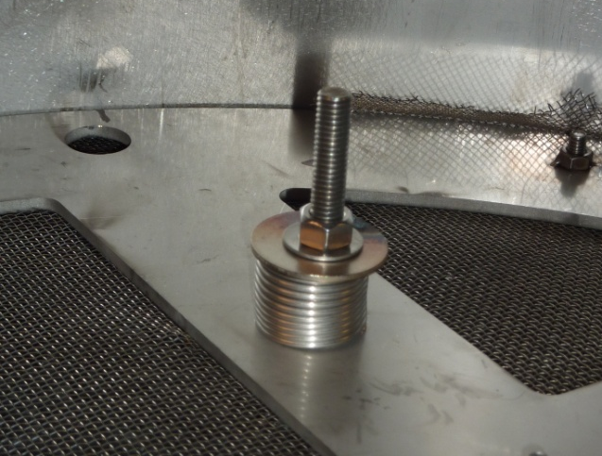
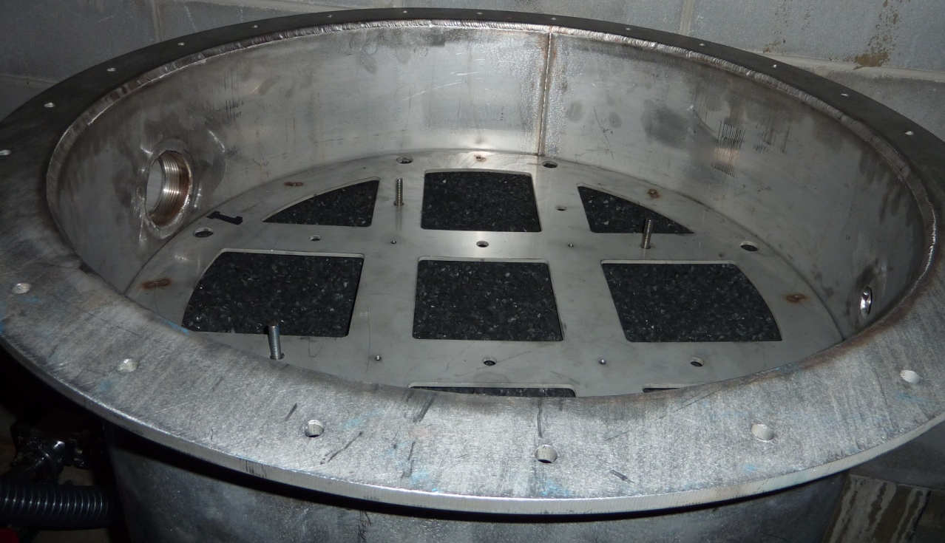
Activated-Carbon Columns
Calgon Coconut Activated Carbon
Product OVC Plus 4x8 (mesh)
Multiply rinsed, then dried
under high-flow fume hoods
Two Identical
Stainless-steel
Vacuum Vessels
Filled with
~125 kg each &
Spring Loaded
Opened up tank after first month commissioning, found carbon still in good shape & well packed.

Slide 29
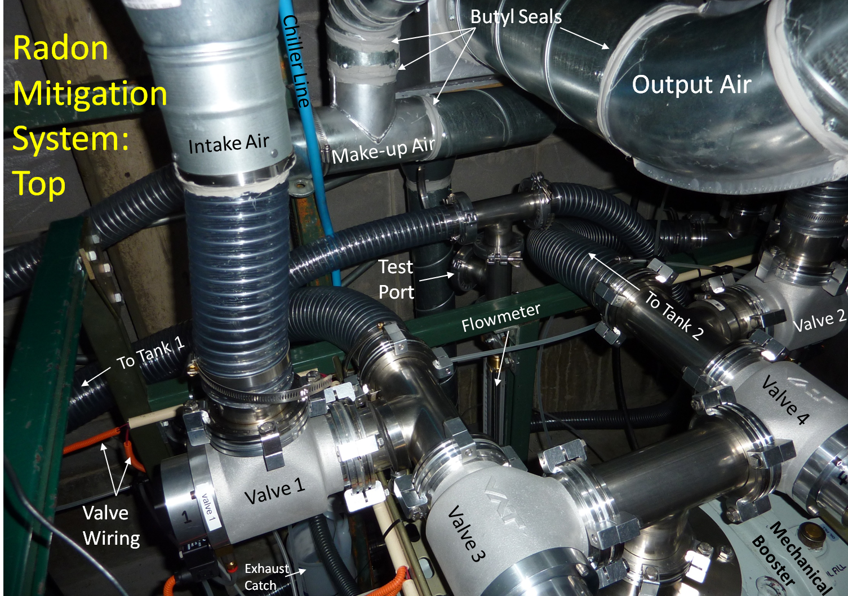
The Syracuse VSA (now at SDSM&T)

Slide 30
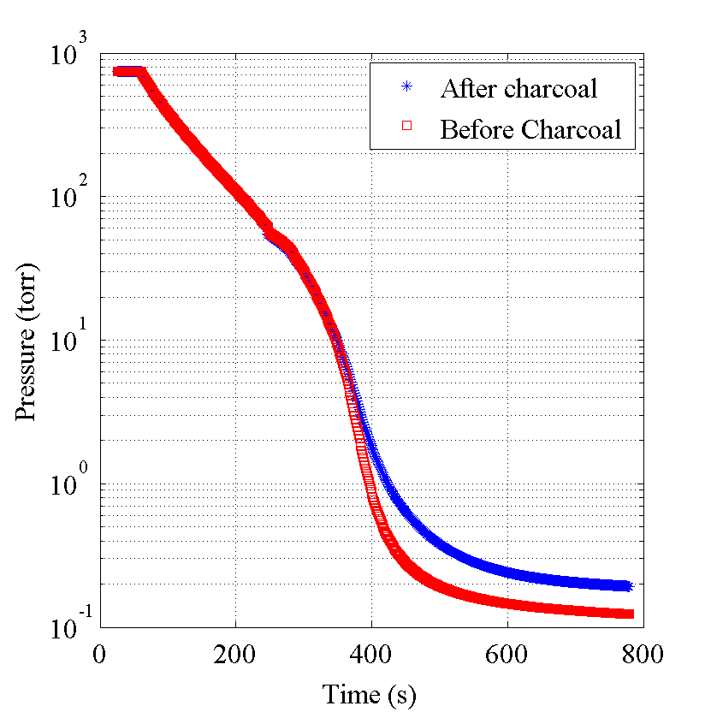
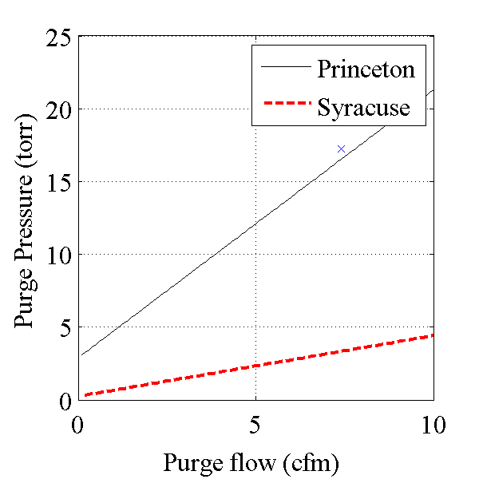
VSA Comparison: Princeton vs Syracuse
Takes 5 minutes to pump down to ≈10 torr (vs Princeton ≈1 min)
→ So part of cycle is inefficient
Lower base pressure allows
higher volume flow gain

Slide 31
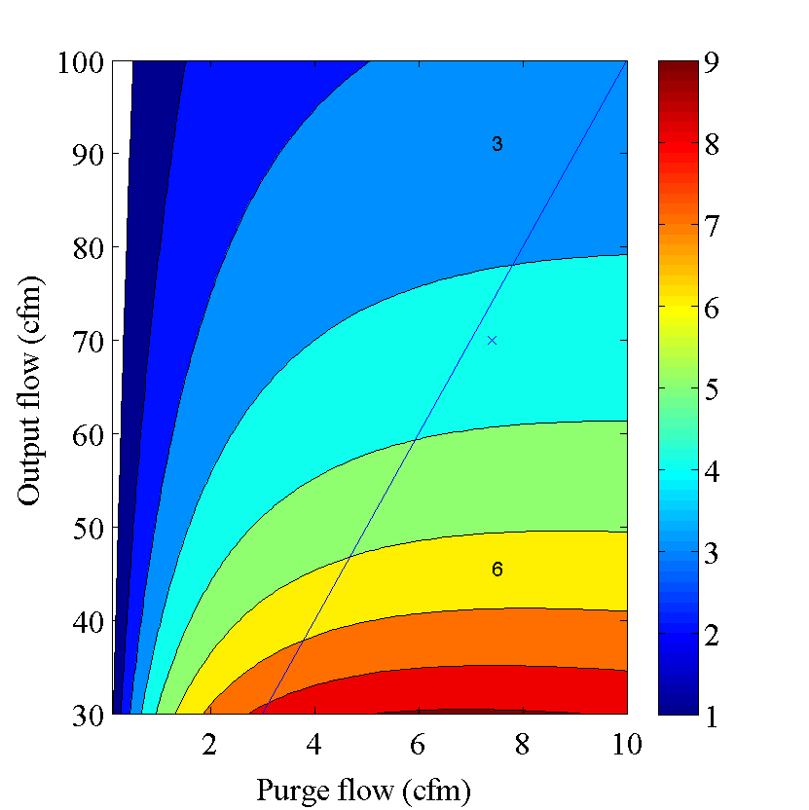
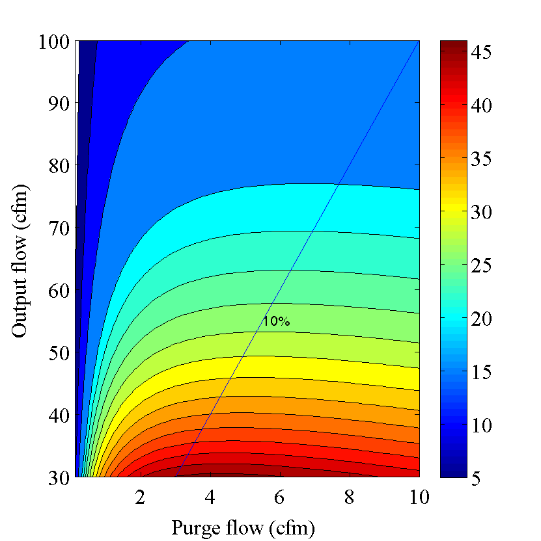
VSA Comparison: Princeton vs Syracuse
Want large G, big output flow and short cycle times:
Must have G > 1 for system to mitigate at all
Note this is not a valid direct comparison
→ same G in different systems can be different performance
Princeton
Syracuse

Slide 32
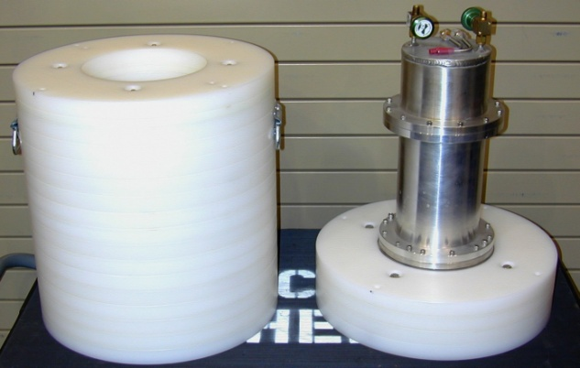
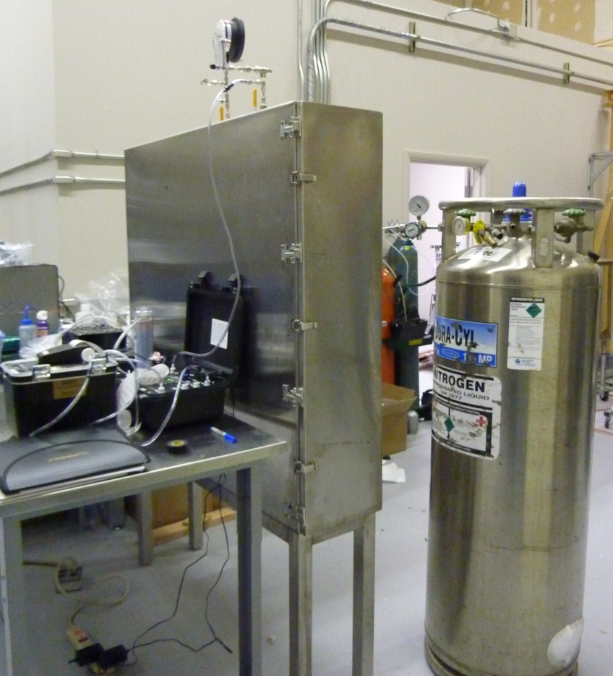
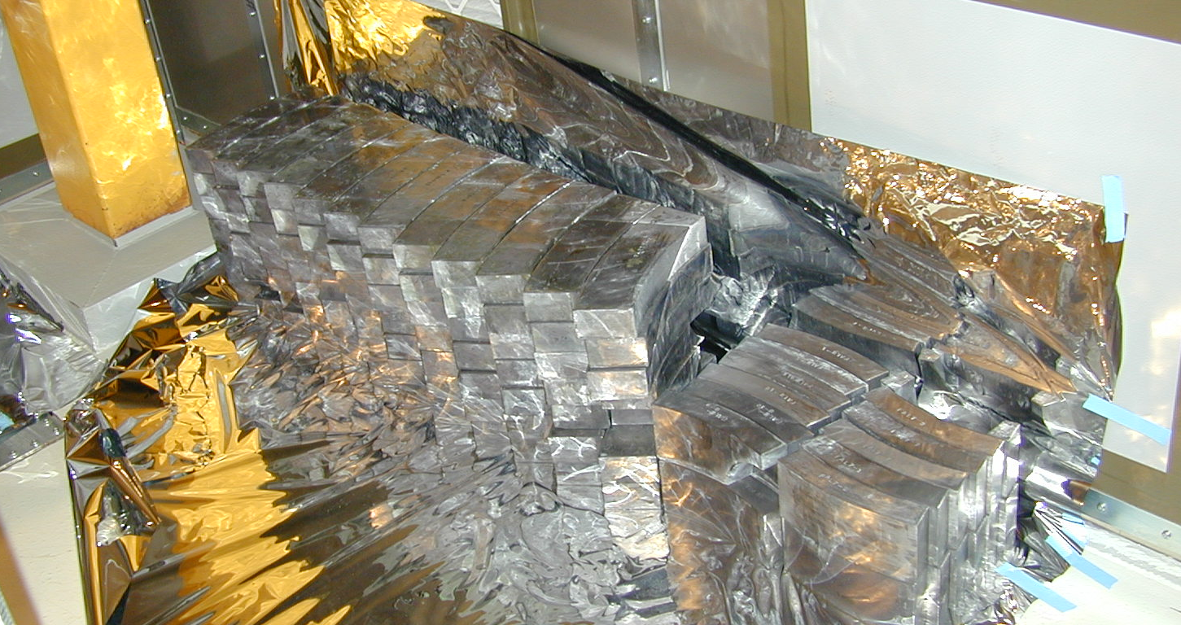
Other Exclusion Techniques
Conventional
Dry Boxes
CDMS II Tower
Vacuum Canister
for Shipping
SDSM&T Metal Purge
Cabinet for BetaCage
Radon-Impervious
Wrappings

