Slide 1
The Ultratrace Determination of Th and U in a Variety of Detector Materials and Components for Use in Ultralow Background Applications
Isaac Arnquist, Brian LaFerriere, tapas maiti, eric hoppe
Pacific Northwest National Labs
LRT Conference

Slide 2
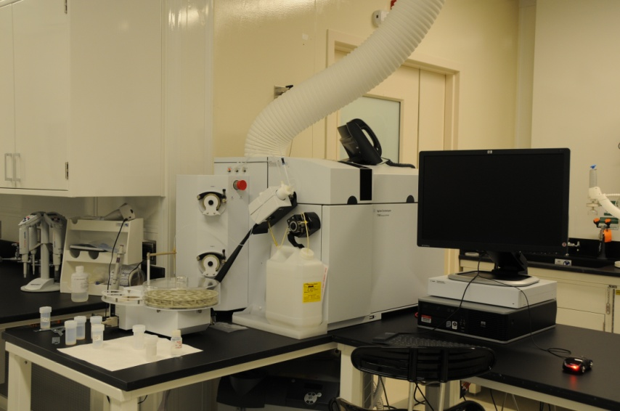
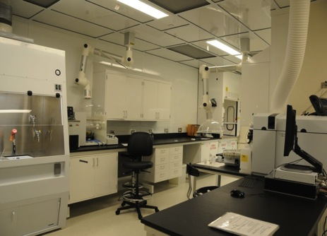
The Setup
ICP-MS analysis for the radionuclide determination in detector components
Isotope dilution analysis using radioactive tracers for U and Th
Gold standard for quantitation
²²⁹Th, ²³³U
Utilize Class 10,000 Cleanroom and Class 10 laminar flowhoods

Slide 3
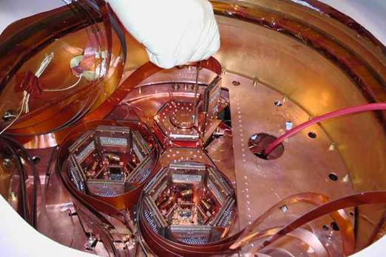
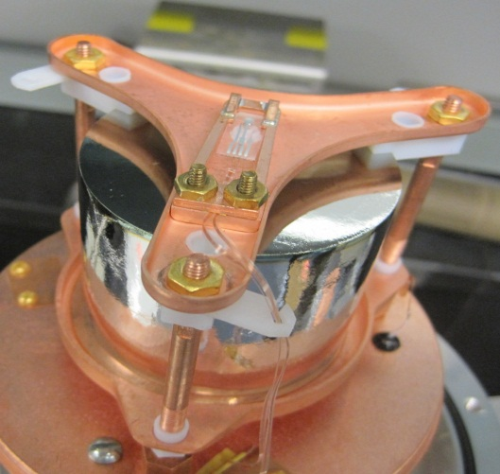
A Smörgåsbord of Samples
Structural and Shielding Components
Cu, Pb, Ti, and Stainless Steel is becoming more routine at lower and lower levels
Specialty Components
Fused Silica
Electronic Components
Linear Alkyl Benzene
Particulates from filters
Polymers

Slide 4
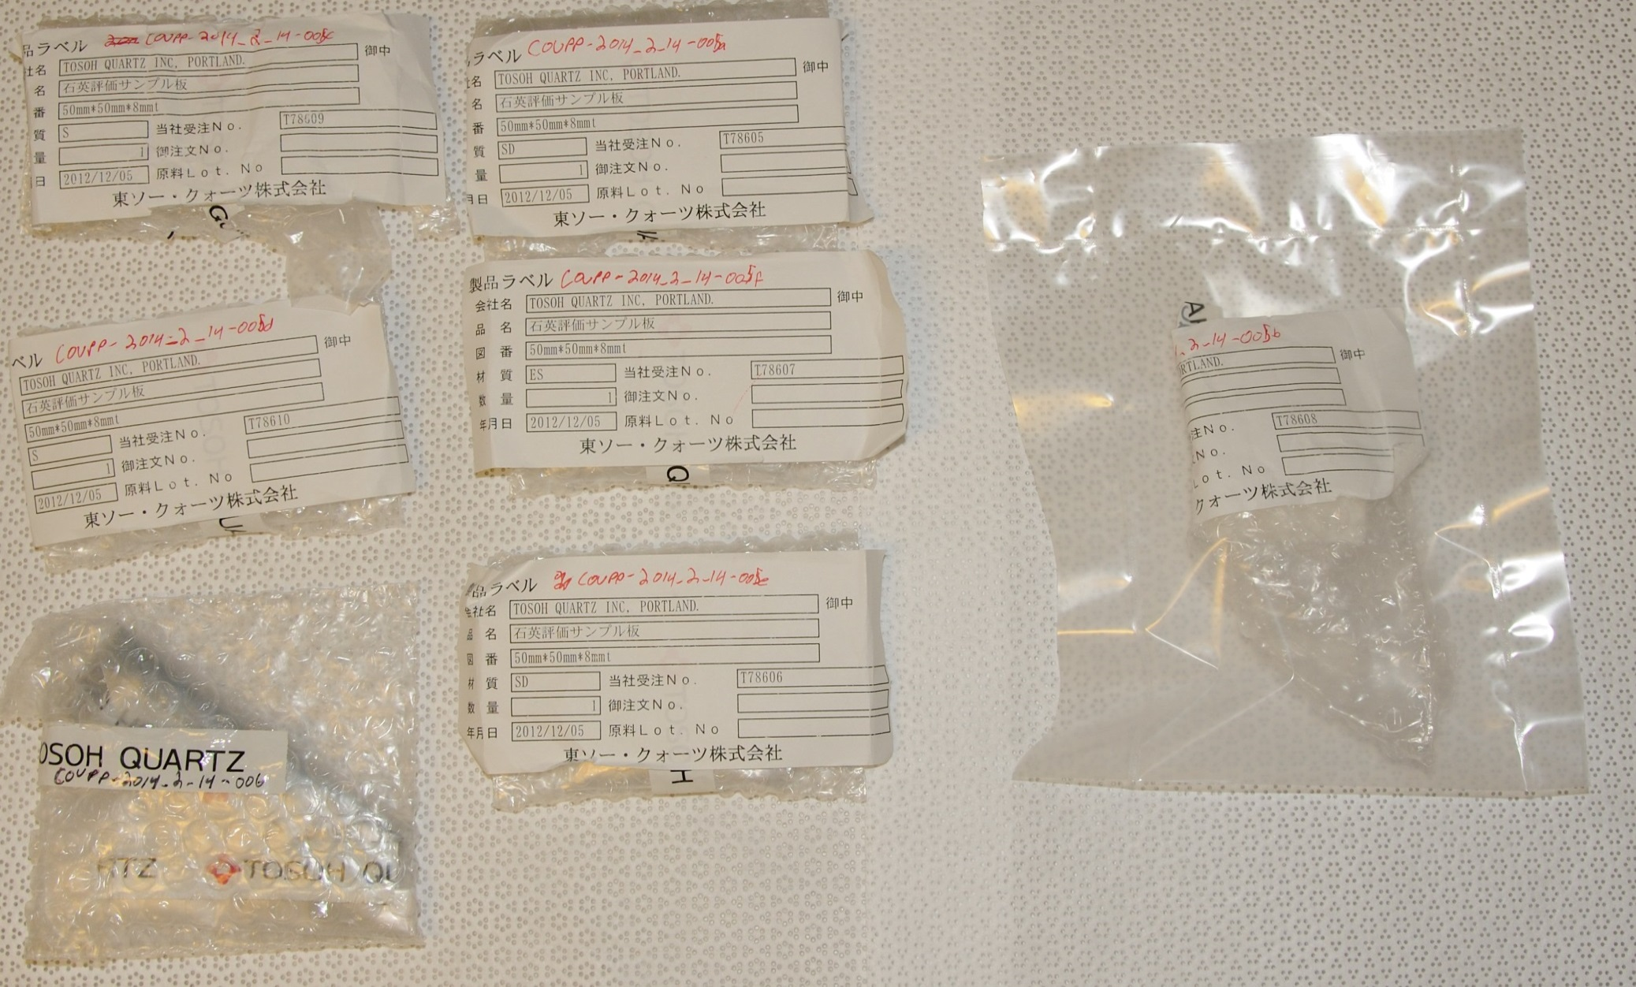
Fused Silica
Sample Size: 70-150 mg
Dissolution in concentrated HF and HNO₃
SiO₂ + 4 HF → SiF₄(g) + 2H₂O
 |  | Th-232 |  | U-238
Sample Name | Rep# | pg/g fused silica | μBq/kg | pg/g fused silica | μBq/kg
Lot_A | Rep1 | <2.26 | <9.25 | 40.4 | 501
Lot_A | Rep2 | 2.82 | 11.6 | 41.6 | 516
Lot_A | Rep3 | 4.13 | 16.9 | 42.0 | 521
Lot_B | - | <2.26 | <9.25 | 37.3 | 463
Lot_C | - | <2.26 | <9.25 | 5.76 | 71.4
Lot_D | - | 2.86 | 11.7 | 6.83 | 84.7
Lot_E | - | 6.12 | 25.1 | 68.4 | 849
Lot_F | Rep1 | 11.9 | 48.7 | 123 | 1527
Lot_F | Rep2 | 12.5 | 51.2 | 101 | 1250
Lot_F | Rep3 | 10.8 | 44.3 | 133 | 1645
Absolute Detection Limits (pg)
Th-232 | U-238
0.250 | 0.308

Slide 5
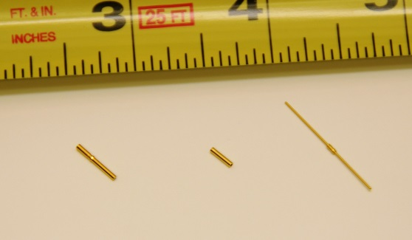
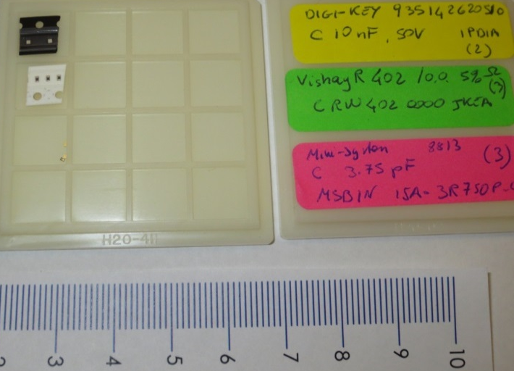
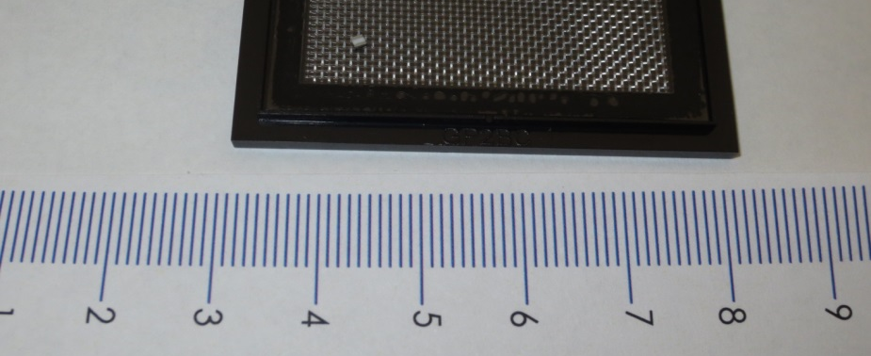
Electronic Components
Sample Size: 0*-35 mg
Dissolution in concentrated HNO₃, HF, and/or HCl
 | Th-232 |  | U-238
Sample | pg/piece | mBq/kg | pg/piece | mBq/kg
Millmax Small Socket1 | 248 | 51.6 | 1083 | 682
Millmax Small Socket2 | 263 | 52.1 | 1139 | 682
Millmax Large Socket1 | 310 | 35.1 | 1390 | 477
Millmax Large Socket2 | 300 | 33.5 | 1421 | 480
Millmax Pin1 | 1.80 | 0.220 | 0.704 | 0.260
Millmax Pin2 | 1.70 | 0.203 | 1.06 | 0.384
SQUID1 | 1.40 | 0.342 | 0.20 | 0.147
SQUID2 | 0.326 | 0.0793 | 0.177 | 0.130
SQUID3 | 0.189 | 0.0459 | 0.0569 | 0.0418
5k Ω Resistor | 0.0352 | - | 0.0160 | -
80 MΩ Resistor | 0.237 | - | 0.111 | -
10 nF Capacitor | 0.0861 | - | 0.0274 | -
HEMT | 0.0670 | - | 0.0557 | -
0 Ω Resistor | 236 | - | 104 | -
RuOx Thermometer | 817 | - | 407 | -
5 mΩ Resistor | 17.0 | - | 109 | -
3.75 pF Capacitor | 2.12 | - | 0.492 | -
L-R: Millmax large and small sockets and pin
10 nF Capacitor, 5 mOhm Resistor, & 3.75 pF Capacitor components
Absolute Detection Limits (pg)
Th-232 | U-238
0.1-0.6 | 0.1-0.4
RuOx Thermometer

Slide 6
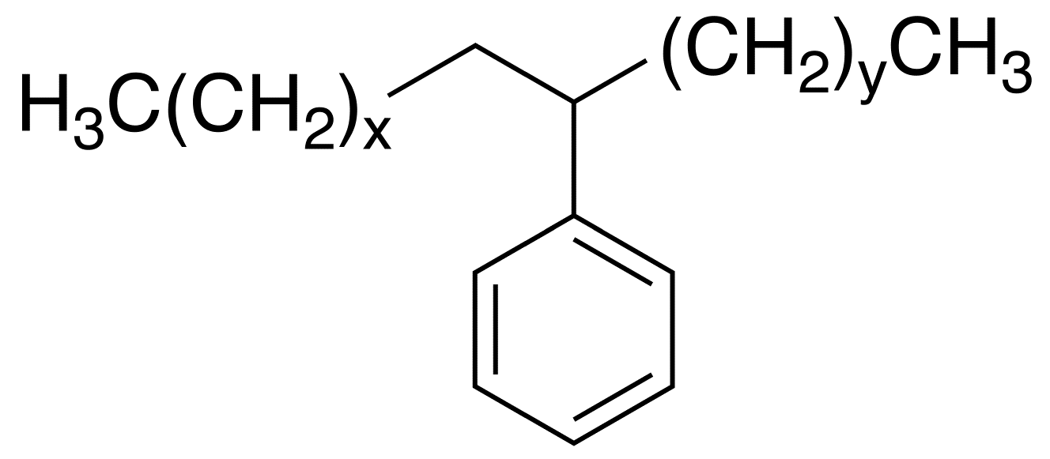
Linear Alkyl Benzene (LAB)
Liquid scintillator with high optical transparency
Very low vapor pressure
b.p. ~300ºC
Sample Size: ~8.5 grams
 |  | Th-232 |  | U-238
Sample Name | Rep# | fg/g LAB | μBq/kg | fg/g LAB | μBq/kg
LAB_A | 1 | <6.61 | <0.0271 | 13.0 | 0.161
LAB_A | 2 | <6.39 | <0.0262 | 14.6 | 0.181
LAB_A | 3 | <6.43 | <0.0264 | 11.8 | 0.147
LAB_B | 1 | <6.55 | <0.0269 | <4.03 | <0.0499
LAB_B | 2 | <6.43 | <0.0263 | <3.95 | <0.0490
LAB_B | 3 | <6.35 | <0.0260 | <3.90 | <0.0484
LAB_C | 1 | 52.1 | 0.214 | 19.6 | 0.243
¥
LAB_C
LAB_A
LAB_B
Absolute Detection Limits (fg)
Th-232 | U-238
54.8 | 33.7
¥ Image from: http://commons.wikimedia.org/wiki/File:Linear_alkylbenzene.png#/media/File:Linear_alkylbenzene.png

Slide 7
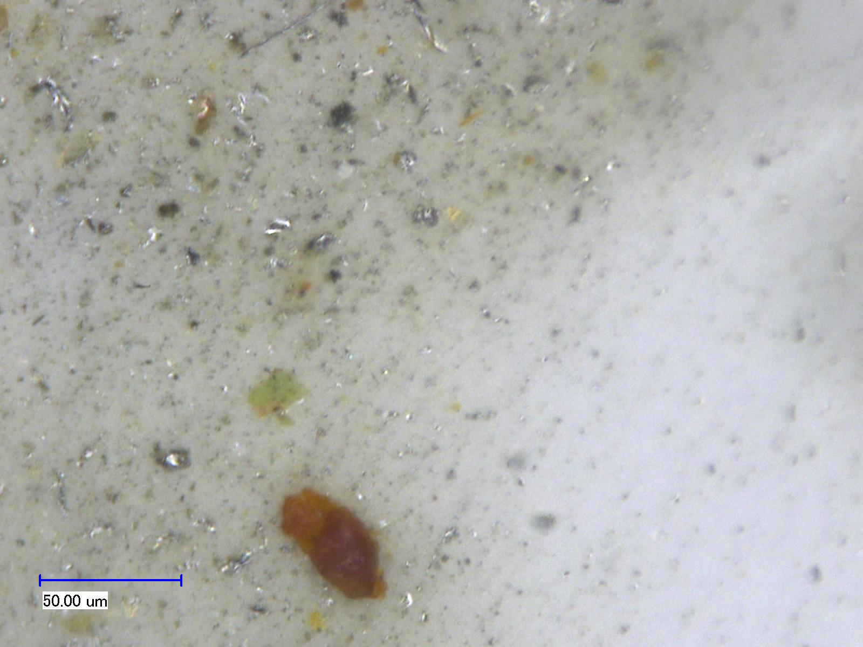
Filter Particulates
PTFE filters with captured particulates were analyzed for U, Th
Sample and blank filters were subjected to particulate dissolution using a mixture of HNO₃ and HF
 | Th-232 | U-238
Sample | pg/filter | pg/filter
Filter_A | <0.607 | <0.497
Filter_B | 7.30 | 0.584
Filter_C | 234 | 10.8
Absolute Detection Limits (pg)
Th-232 | U-238
0.607 | 0.497

Slide 8
Polymethyl Methacrylate (PMMA)
Dry-ash PMMA in ultralow background electroformed copper crucibles using a tube furnace under air flow (2L/min)
Dissolve crucible/residue and isolate U, Th using anion exchange separation¥
 | Th-232 |  | U-238
Sample | fg/g PMMA | μBq/kg | fg/g PMMA | μBq/kg
PMMA1 | <183 | <0.750 | 154 | 1.91
PMMA2 | 269 | 1.10 | 202 | 2.51
PMMA3 | <182 | <0.746 | 162 | 2.01
Absolute Detection Limits (fg)
Th-232 | U-238
27.5 | 21.0
Method will be presented at the MARC X conference in April 2015
¥ B.D. LaFerriere et al. / Nuclear Instruments and Methods in Physics Research A 775 (2015) 93-98.

Slide 9
Conclusions
ICP-MS and well-crafted sample preparation methodology allows for the analysis of specialty components important in ultralow background physics experiments
Microgram-samples
Nonpolar compounds
Polymers

Slide 10
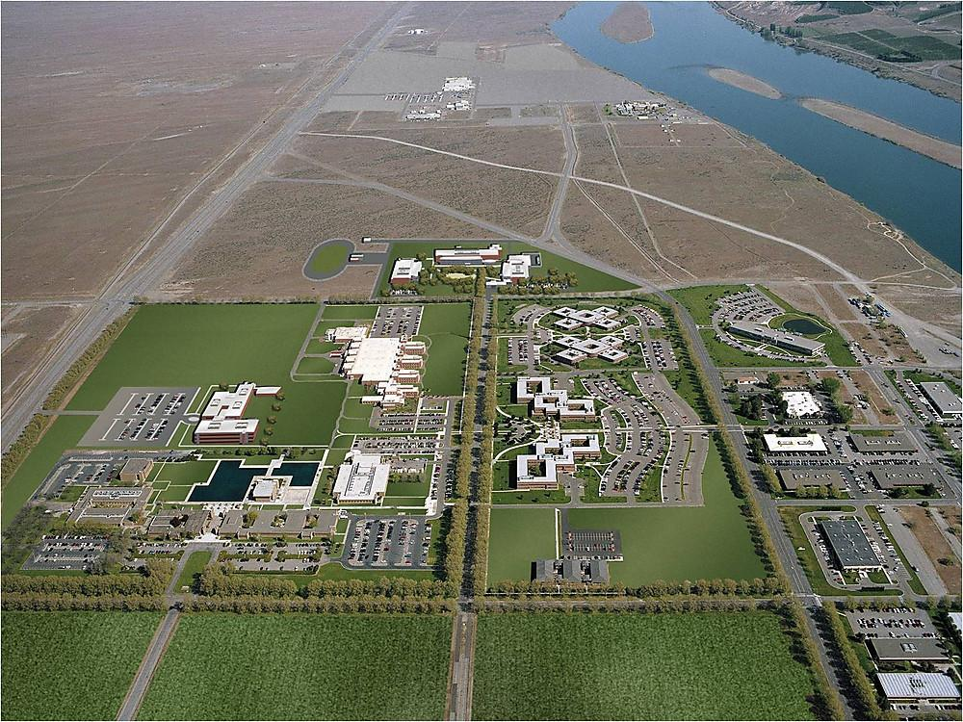
Acknowledgments
Eric Hoppe
Brian LaFerriere
Tapas Maiti
May-Lin Thomas
Jay Grate
Mary Bliss
Jeter Hall
John Orrell

Slide 11
Questions?

