Slide 1
Background analysis techniques in the cuore experiment
Barbara S. Wang, on behalf of the CUORE Collaboration
Low Radioactivity Techniques 2015 Workshop
Seattle, WA
March 18 – 20, 2015

Slide 2
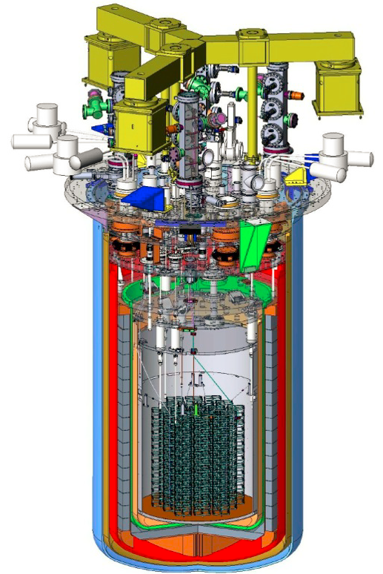
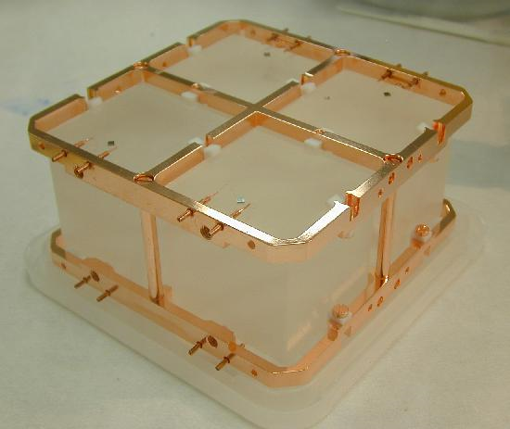
Cuore detector
Cryogenic Underground Observatory for Rare Events (CUORE)
  Will search for 0νββ decay of ¹³⁰Te (Q-value = 2528 keV)
  Detector is an array of 988 natural TeO₂ bolometers:
    19 towers; 13 floors/tower; 4 bolometers/floor
    741 kg total; 206 kg ¹³⁰Te
    Isotopic abundance of ¹³⁰Te is 34%
    Array will be held in a cryostat and cooled
    to ~10 mK
  Data taking to start in late 2015.

Slide 3
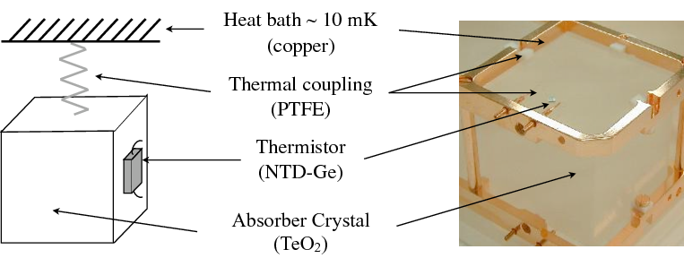
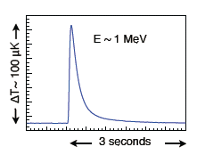
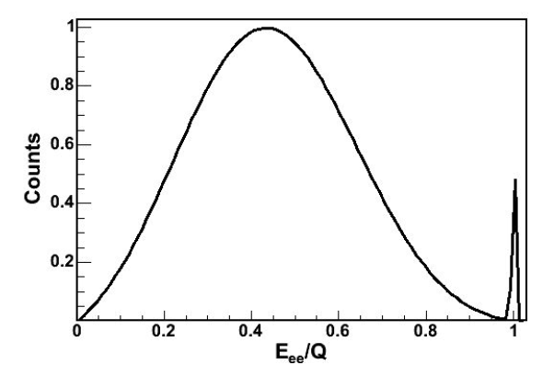
Bolometric technique
Typical CUORE pulse
TeO₂ bolometers:
  Particle interaction deposits energy in crystal.
  Resulting temperature rise (∆T) measured.
  Energy deposition determined from E = C ∆T
  (C is heat capacity).
0νββ decay signature: peak at Q-value
  Energy resolution at 2528 keV:
  FWHM ~ 5-7 keV
Not to scale
2νββ
0νββ
Counts
ΔE/Q

Slide 4
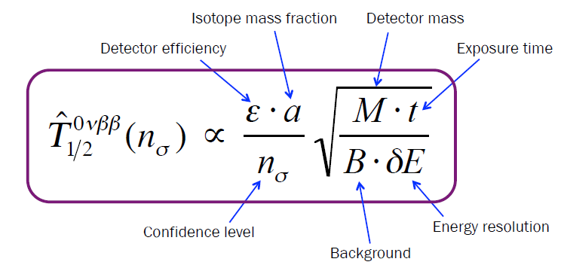
Half-life sensitivity

Slide 5
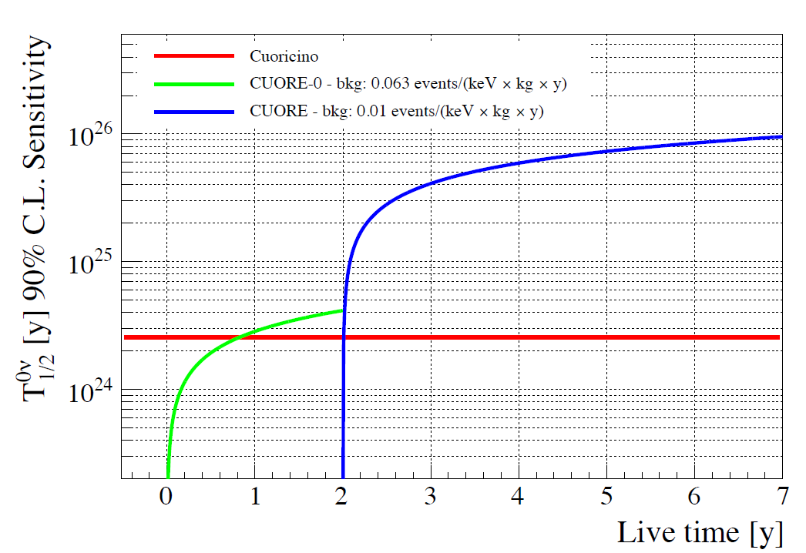

Half-life sensitivity
CUORE
Background Goal
$9.5×{10}^{25}$y
Corresponds to m_{ββ} = 51-133 meV (90% C.L.)

Slide 6
Background analysis techniques
Gamma spectroscopy w/ HPGe detectors
Neutron activation analysis
Alpha spectroscopy w/ Si surface barrier detectors
ICP-MS
Bolometry w/ TeO₂
Cross-section measurements for cosmogenic-isotope production in detector materials (e.g., Te)
Data-analysis cuts
Monte Carlo simulations
Notes:
Bolometry w/ TeO₂ (able to reach sensitivities of a few nBq/cm³)

Slide 7
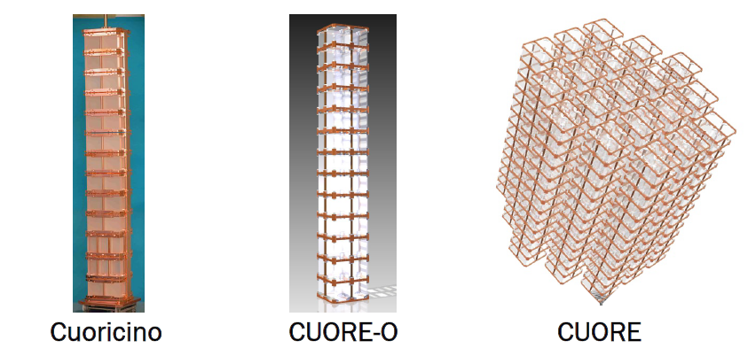
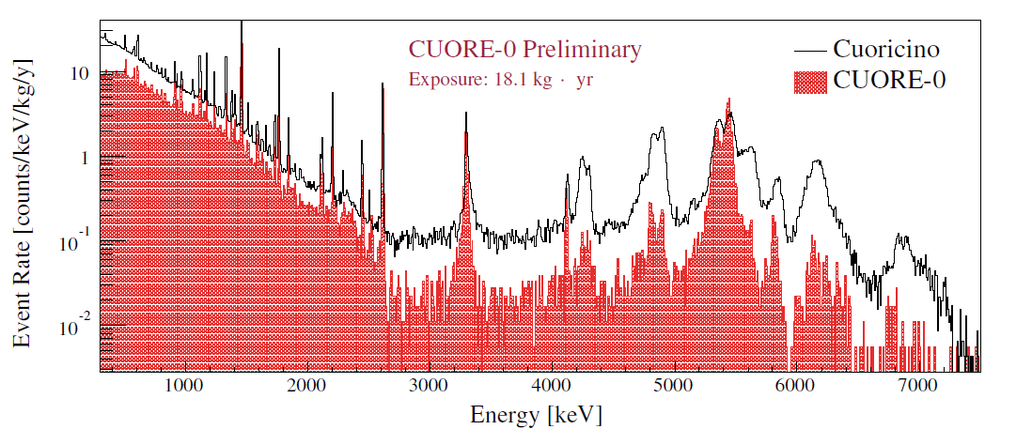
Background spectra
Only events that occur in a single crystal are plotted. These are known as multiplicity 1 (M1) events.
2003-2008
March 2013-Spring 2015
M1 spectra
alphas
M1 spectra
Gammas, betas
0νββ region

Slide 8
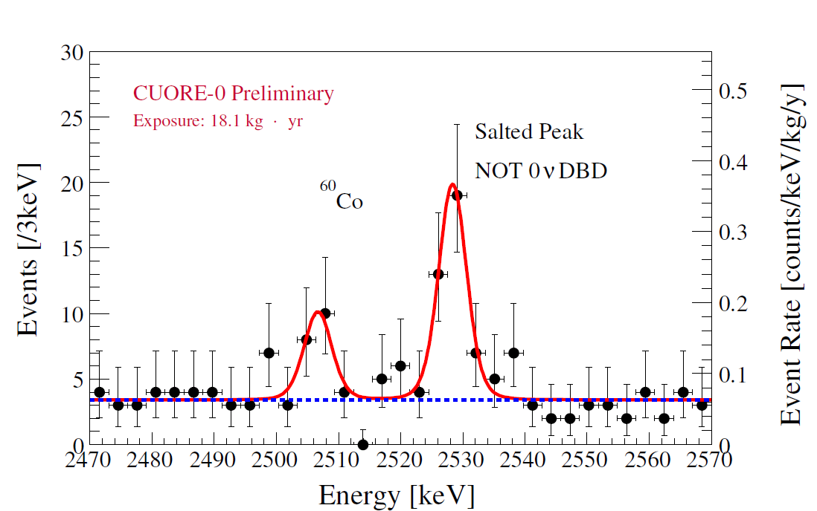
Neutrinoless double-beta decay region
0νββ-decay region:
Excellent energy resolution (~5 keV) at 2528-keV Q value allows the 0νββ-decay peak to be unambiguously distinguished from the ⁶⁰Co sum peak.
M1 spectrum

Slide 9
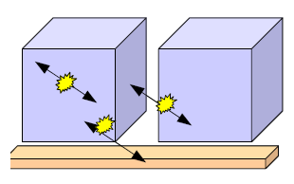
Alpha background
Alpha decay: Q_{α} = E_{α} + E_{R}
Alpha background comes from
  Bulk contamination of TeO₂ crystals
    Deposits Q_{α} in crystal
  Surface contamination of TeO₂ crystals
    Fully contained event: deposits Q_{α} in crystal.
    Partially contained event: alpha (or recoil) loses energy in crystal before escaping completely or depositing remaining energy in an adjacent crystal
  Surface contamination of the copper frames
    Alpha loses energy in copper before depositing remaining energy in TeO₂ crystal
“Degraded” alphas:
  Alphas that deposit partial energy in the crystals
  Background extends from Q_{α} or E_{α} down to zero

Slide 10
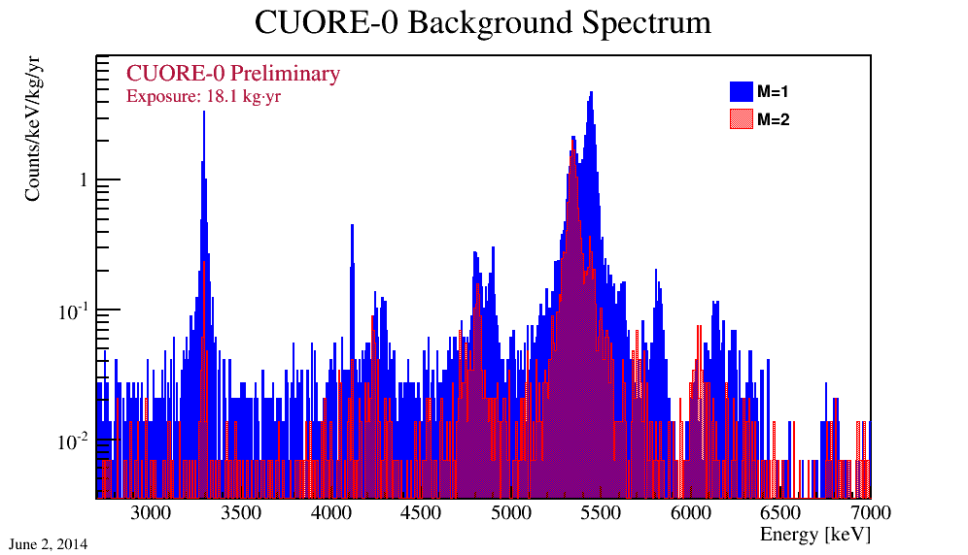
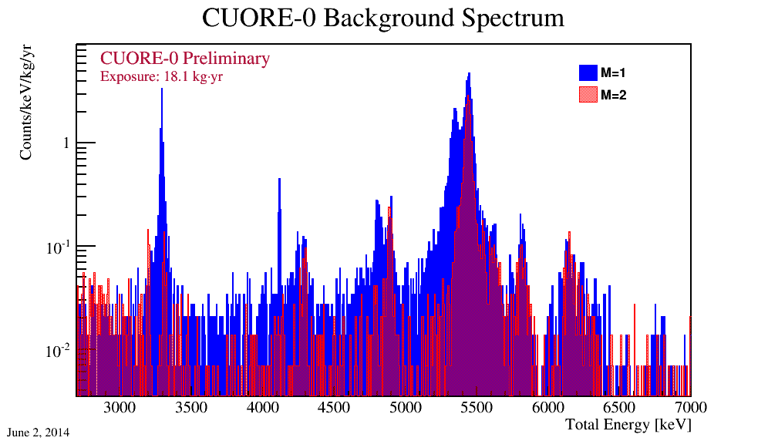
Alpha background
Crystal bulk and surface events can be disentangled by comparing spectra for single-crystal events (M1) with those for two-crystal events (M2)
Energy deposited in individual crystals during each event is plotted
Energy deposited in entire detector array during each event is plotted

Slide 11
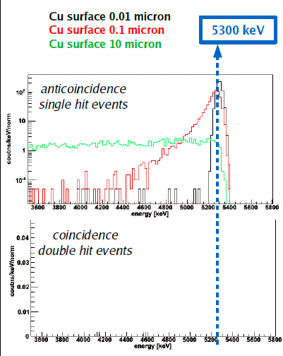
Alpha background
Degraded-alpha signature from Po-210 surface contamination on copper
Simulation results for different contamination thicknesses shown
Energy deposited in individual crystals during each event plotted
M1
M2

Slide 12
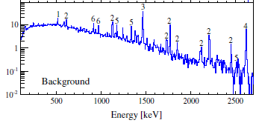
Gamma/beta region
Dominated by Th-232 and U-238 contaminations in the cryostat and/or its shields.
CUORE-0
M1 spectrum
0νββ
e⁺e⁻ annihilation
²¹⁴Bi
⁴⁰K
²⁰⁸Tl
⁶⁰Co
²²⁸Ac

Slide 13
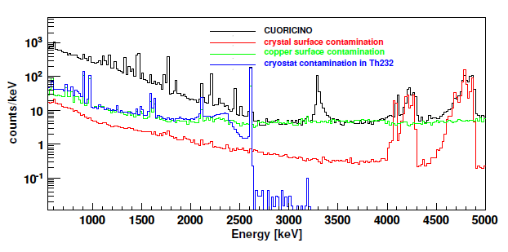
Background model and monte carlo simulations
Three major contributors to 0νββ-decay region:
  10 ± 5%: U-238 and Th-232 surface contaminations of crystals
  50 ± 20%: Th-232 surface contaminations of copper (or any other component facing crystals)
  30 ± 10%: multi-Compton events from Tl-208 2614 keV line (due to Th-232 contamination in cryostat)
M1 spectra

Slide 14
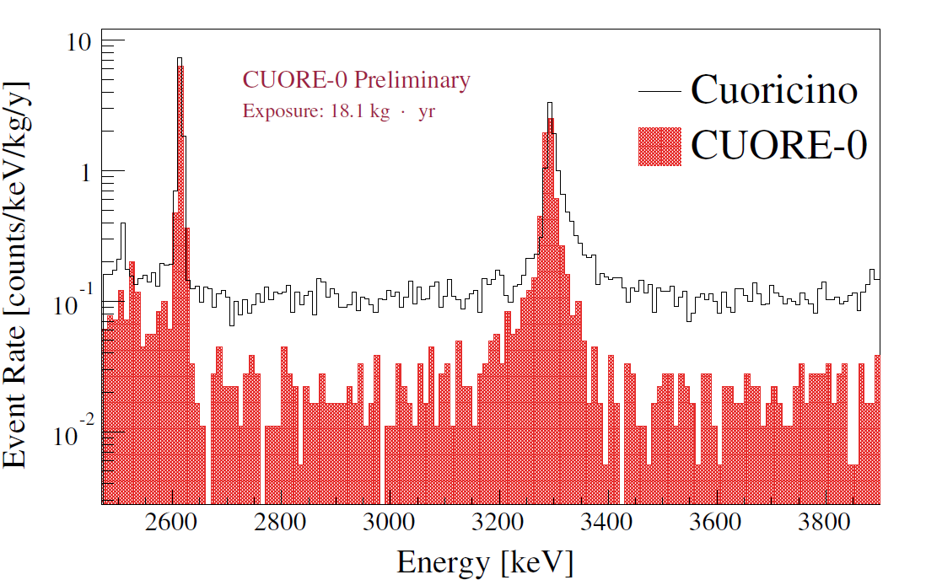
Improving the alpha background
CUORE-0 has achieved an overall background 2 times lower than Cuoricino and an alpha background 6 times lower.
Due largely to more rigorous copper cleaning methods and more consistent cleaning protocol for crystals.
M1 spectra
First results from CUORE-0 published in The European Physical Journal C 74, 2956 (2014)

Slide 15
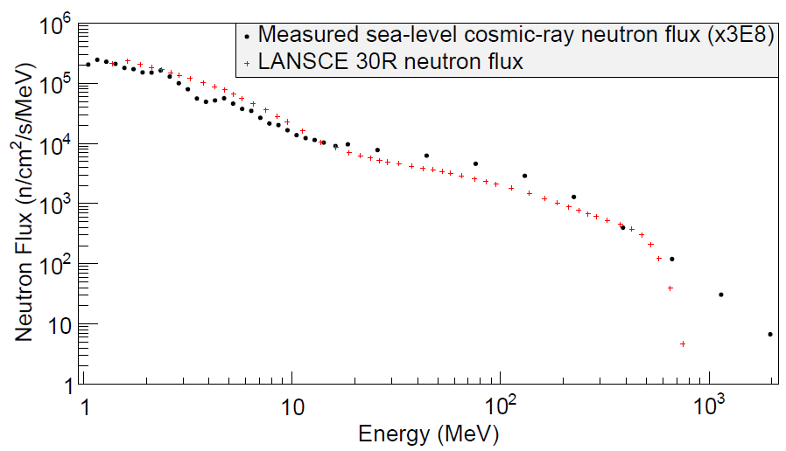
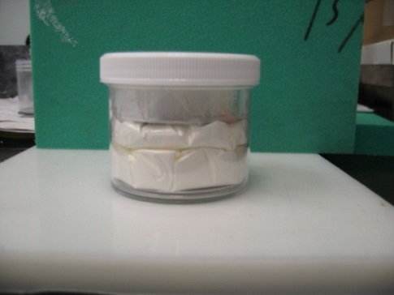
Cosmogenic background
Background from ^{110m}Ag and ⁶⁰Co present due to cosmogenic activation of TeO₂ crystals.
Background estimated using radioisotope-production cross sections measured at the Los Alamos Neutron Science Center (LANSCE).
  TeO₂ powder irradiated w/ a neutron spectrum similar in shape to the cosmic-ray neutron spectrum at sea-level.
  Cross sections obtained¹: ^{110m}Ag: 0.28 ± 0.04 mb, ⁶⁰Co: < 0.0016 mb
¹ Paper on the cross-section measurement submitted to Physical Review C. Preprint may be found here: http://arxiv.org/abs/1503.02095

Slide 16
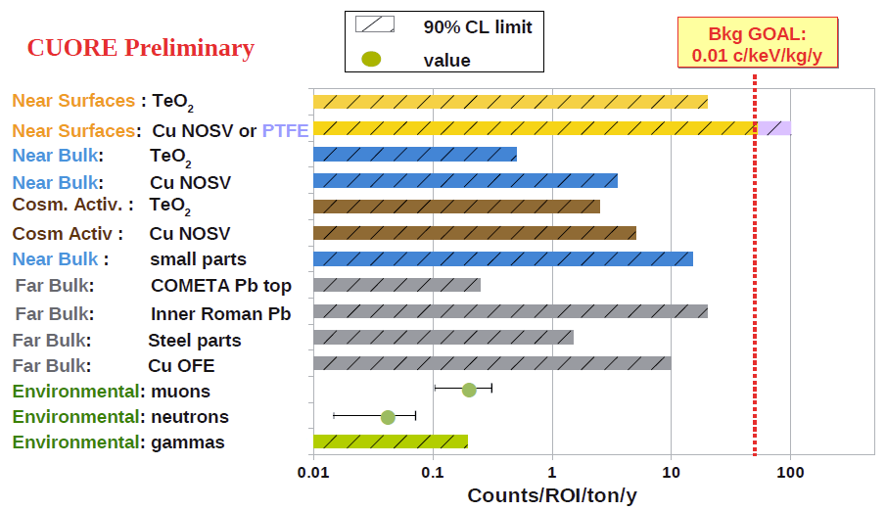
Background budget

Slide 17

Thank you for listening. Questions?

