Slide 1



Selective precipitation of potassium in seawater samples for improving the sensitivity of plain γ-ray spectrometry
Marco Ferrante,Matthias Laubenstein
Stefano Nisi, Francesco De Angelis

Slide 2
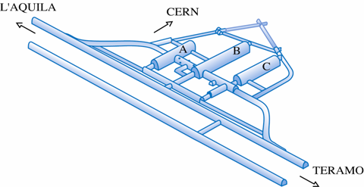
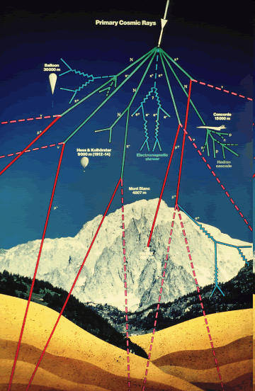
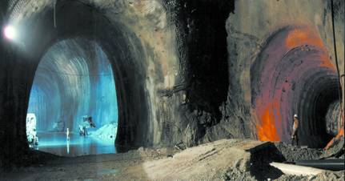
The Gran Sasso National Laboratory
1400 m rock coverage
Muon flux reduction factor: 10⁶

Slide 3
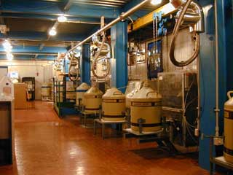
  STELLA = SubTErranean Low Level Assay
In STELLA a lot of different samples with radiometric method and high sensitivity are measured.
12 HPGe detectors
4 silicon alpha detectors.
2 liquid scintillation counters (ultra low background)
7 active gas radon detectors
To select the material for the underground experiments
To do measurements of scientific interest

Slide 4
Research goal
The γ-spectroscopy measurements of some radionuclides, such as Th, U, Cs, Pb, Co, Ra and I in seawater samples with low levels of concentration, is very difficult for the high concentration of potassium in the matrix. Its Compton continuum makes the identification of the elements of interest rather difficult.
The goal of this work was the identification of a chemical method for the removal of K from sea water samples. Analytical techniques such as ICP-MS and AAS were used to check the efficiency.

Slide 5
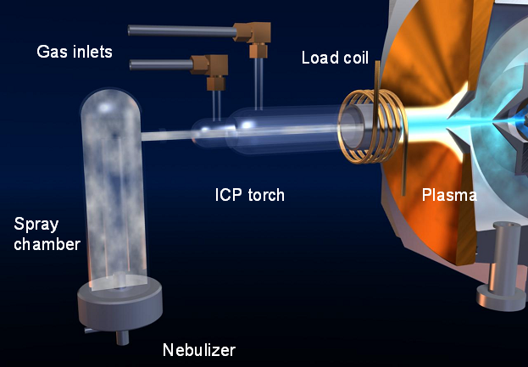
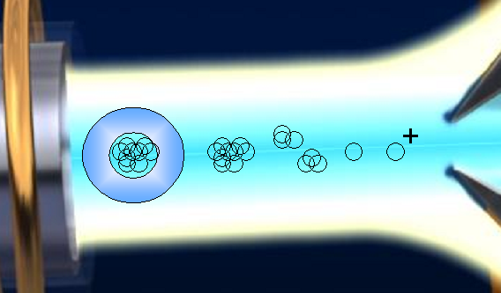
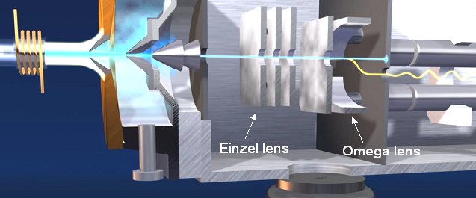
ICP-MS
Atomization and Ionization
Sample
Introduction
Analisis and
Detection

Slide 6
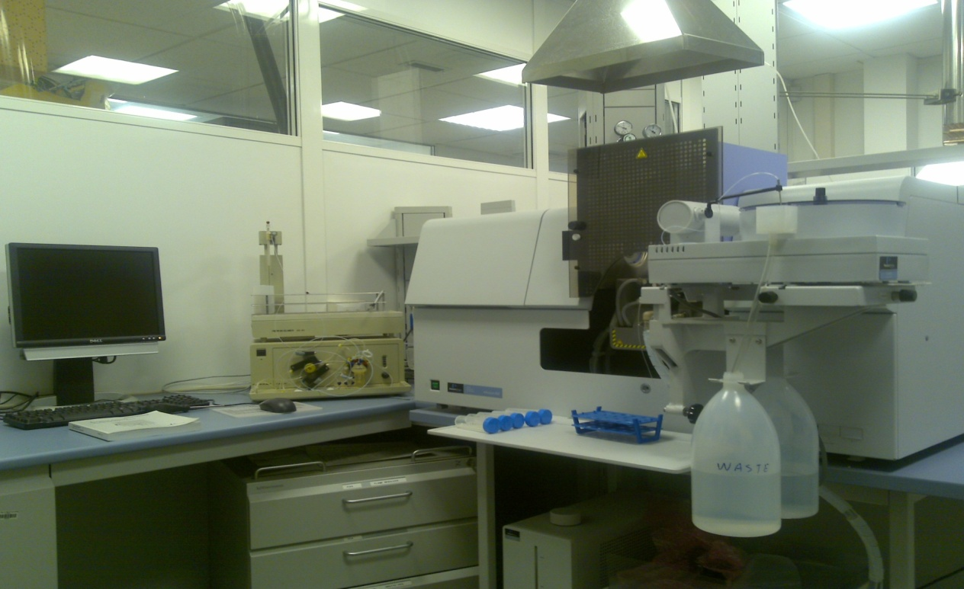
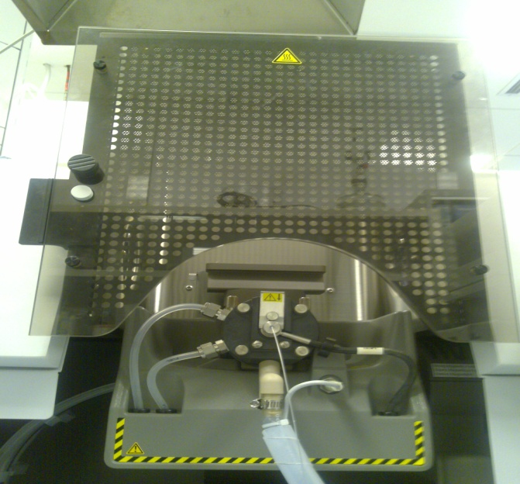
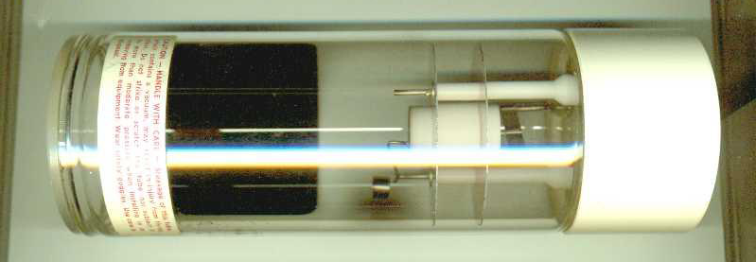
Atomic Absorption Spectometry (AAS)
Quantitative and qualitative analysis;
No strong dilution;

Slide 7
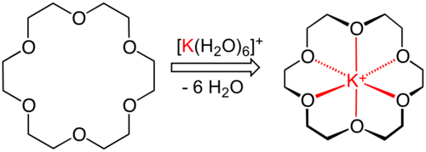
Experimental Research
Step 1
18-Crown-6 (1,4,7,10,13,16-hexaoxacyclooctadecane) liquid-liquid extraction technique (Toluene, Chloroform,Benzene)
Simulate samples (KMnO₄) and small volumes (50 mL)
Evaluate the real selectivity of Crown Ether for K.
 | K removal %
Toluene | 27,9
Chloroform | 24,3
Benzene | 24,9
AAS quantitative analysis.
Unsatisfactory results for our purposes.
Crown ethers are expensive.

Slide 8
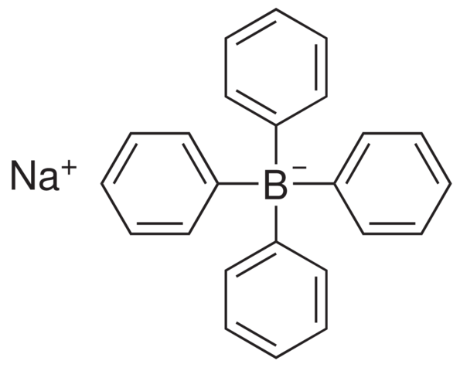
Experimental Research
Step 2
Sodium Tetraphenylborate Technique
Developed by Witting (1950), Raff and Brotz (1951) actually is often use with seawater samples
[B(C₆H₅)₄]⁻ + K⁺ → K[B(C₆H₅)₄]↓
The solubility of precipitate is lower between pH 4 and 6;
K_{ps}~ 2.3 x 10⁻⁸ (20 °C);
Co-precipitation of Calcium e Magnesium is minimized with Na₂CO₃ glacial acetic acid;
Rb⁺, Cs⁺, NH₄⁺, Hg⁺, Ag⁺, Tl⁺ form stable precipitates

Slide 9
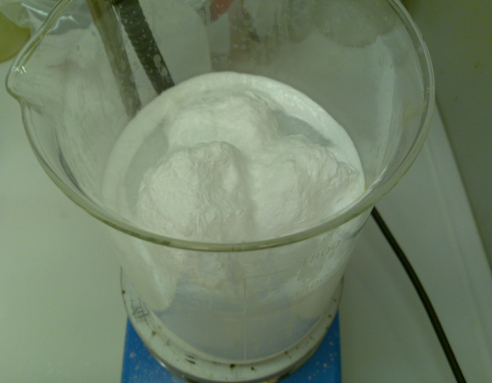
Experimental work
1L Seawater Sample
100 mL of Na₂CO₃ 5% solution
Filter 0,4 µm
Filtered seawater
3.42 g Sodium Tetraphenylborate and 0,5 g of Al₂O₃ dissolved in 100 mL of Milli-q water and Glacial Acetic Acid
Filter 0,4 µm
Stirring
Stirring
PET bottle conditioned with HNO₃ 10% UP
Seawater
+
Na₂CO₃

Slide 10
Experimental work
Analysis by AAS
Method validation:
            Selectivity
            Reproducibility
            Efficency
Calibration with 6 potassium standards
    0.5 ppm
    1 ppm
    2 ppm
    5 ppm
    10 ppm
    20 ppm
 | Seawater | Seawater+tetraphenylborate
 | K (ppm) | K (ppm)
 | 516 | 35.5
 | 519 | 34.7
 | 525 | 35
Average | 520 | 35.1
93.25 %

Slide 11
Method Validation
Selectivity
We spiked the samples with10 ppm of I and 20 ppb of U,Th,Cs,Co,Pb.
The analysis is made by quantitative ICP-MS.
volatile compounds
(Iodine,hydrogen iodide)
The selectivity of Tetraphenylborate for Cesium is described in literature.
Quantum mechanical calculations made with Gaussian03 and GaussView 3.07

Slide 12
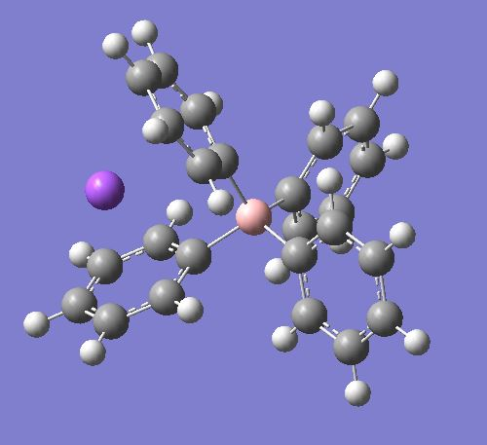
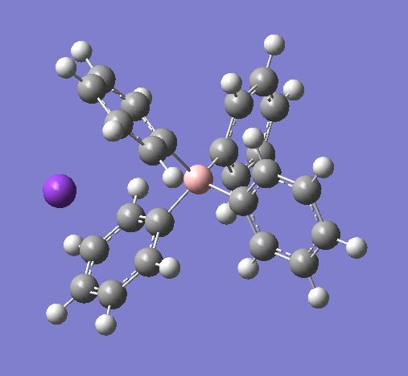
Method Validation
Selectivity
Quantum Mechanical Calculations
HF/631G | K⁺ | Na⁺ | [B(C₆H₅)₄]⁻ | K[B(C₆H₅)₄] | Na[B(C₆H₅)₄]
Hartree | -598.971672 | -161.659276 | -944.892377 | -1544.02115 | -1106.73756
Kcal/mole | -355854.7242 | -101441.1957 | -592919.9666 | -968873.2716 | -694477.8189
[B(C₆H₅)₄]⁻ + Na⁺ → Na[B(C₆H₅)₄]↓
ΔG =-0.19 Hartree or -119.225 Kcal/mol;
[B(C₆H₅)₄]⁻ + K⁺ → K[B(C₆H₅)₄]↓
ΔG =-0.43 Hartree or -269.825 Kcal/mol
HF/SDD | Na⁺ | Cs⁺ | [B(C₆H₅)₄]⁻ | Na[B(C₆H₅)₄] | Cs[B(C₆H₅)₄]
Hartree | -161.65927 | -19.72641 | -944.97283 | -1106.73756 | -964.82874
Kcal/mole | -101441.1919 | -12378.32228 | -592970.4508 | -694477.8227 | -605430.0344
[B(C₆H₅)₄]⁻ + Na⁺ → Na[B(C₆H₅)₄]↓
ΔG = -0,11 Hartree or -69,025 Kcal/mol;
[B(C₆H₅)₄]⁻ + Cs⁺ → Cs[B(C₆H₅)₄]↓
ΔG =-0,13 Hartree or -81,575 Kcal/mol

Slide 13
Method Validation
Repeatability
The process was applied to three aliquots of a water sample and the process was repeated after one week and after 4 weeks.
 | Day 0 |  | After a week |  | After 4 weeks
 | K[ppm] | % K | K[ppm] | % K | K[ppm] | % K
H₂O Seawater | 412±41 |  | 416±42 |  | 360±36
H₂O+TFB Rep 1 | 2.2±0.2 | 99.4 | 2.8±0.3 | 99.3 | 13.2±1.3 | 96.3
H₂O+TFB Rep 2 | 5.4±0.5 | 98.7 | 8.3±0.8 | 98.0 | 8.8±0.8 | 97.6
H₂O+TFB Rep 3 | 2.5±0.2 | 99.4 | 3.4±0.3 | 99.2 | 8.2±0.8 | 97.7
The method is repeatable

Slide 14
Method Validation
Efficiency
To verify the method efficency, a synthetic sample of seawater was prepared and processed with the tetraphenylborate method. The results are compared with the real sample.
 | K [ppm] | % K precipitated
Seawater | 412±41
Synthetic Seawater | 492±49
H₂O +TFB Rep 1 | 2.2±0.2 | 99.4
H₂O +TFB Rep 2 | 5.4±0.5 | 98.6
H₂O +TFB Rep 3 | 2.5±0.2 | 99.4
SyH₂O+TFB Rep 1 | 8.6±0.8 | 98.2
SyH₂O+TFB Rep 2 | 6.5±0.6 | 98.7
SyH₂O+TFB Rep 3 | 3.4±0.3 | 99.3
The results are comparable

Slide 15
Method Validation
Efficiency
Reagent stability test.
 | Day 0 |  | After a week |  | After 4 weeks
 | [ppm] | % K | [ppm] | % K | [ppm] | % K
H₂O seawater | 412±41 |  | 416±42 |  | 360±36
Synthetic seawater | 492±49 |  | 449±45 |  | 492±49
H₂O +TFB Repl 1 | 2.2±0.2 | 99.4 | 2.9±0.3 | 99.3 | 13.2±1.3 | 96,3
H₂O +TFB Rep 2 | 5.4±0.5 | 98.7 | 8.3±0.8 | 98.0 | 8.8±0.8 | 97,6
H₂O +TFB Rep 3 | 2.5±0.2 | 99.4 | 3.4±0.3 | 99.2 | 8.2±0.8 | 97,7
syH₂O +TFB Rep 1 | 8.6±0.8 | 98.2 | 8.3±0.8 | 98.1 | 8.2±0.8 | 98,3
syH₂O +TFB Rep 2 | 6.5±0.6 | 98.7 | 3.4±0.3 | 99.8 | 8.3±0.8 | 98,3
syH₂O +TFB Rep 3 | 3.4±0.3 | 99.3 | 4.6±0.4 | 99.0 | 8.6±0.8 | 98,2

Slide 16
Method Validation
Blank test
To prevent the possibility of contamination by the various reagents and instruments used during the procedure of precipitation (beakers, flasks, Milli-Q water, Na₂CO₃, Acetic Acid, etc. ..) we performed some blank tests.
Element | Conc. | Blank test 1 | Blank test 2
Co | [ppb] | <0.3 | <0.3
I | [ppm] | <0.5 | <0.5
Cs | [ppb] | <0.5 | <0.5
Pb | [ppb] | <0.5 | <0.5
Th | [ppb] | <0.5 | <0.5
U | [ppb] | <0.5 | <0.5
There is no external contamination

Slide 17
Sample preparation and analysis
Samples for γ-spectroscopy measument were prepared.
Potassium removal efficiency was checked by ICP-MS quantitative analysis.
 | K[ppm] | % K
Seawater | 460±50
H₂O +TFB | 0.98±0.09 | 99.8
Sample 1
 | K[ppm] | % K
Seawater | 330±30
H₂O +TFB | 25±3 | 92.4
Sample 2
 | K[ppm] | % K
Seawater | 360±40
H₂O +TFB | 13±1 | 96.3
Average |  | 96.6
Sample 3

Slide 18
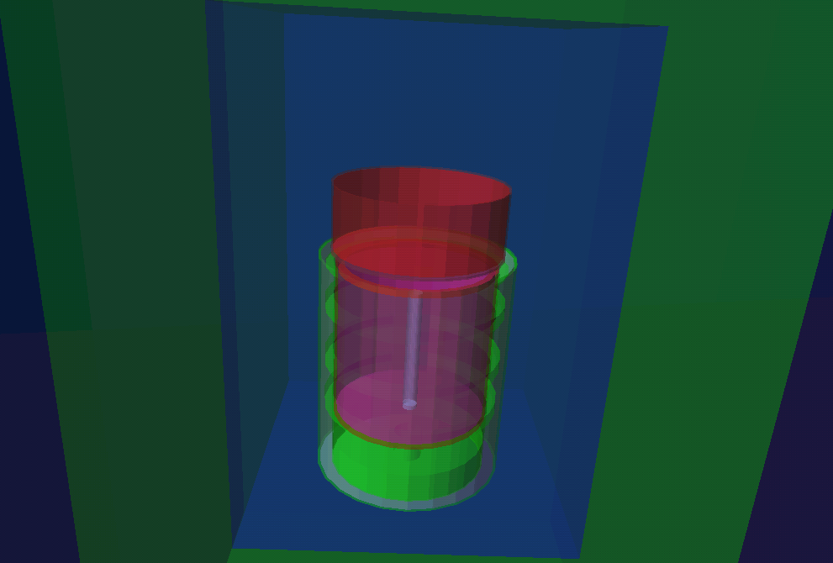
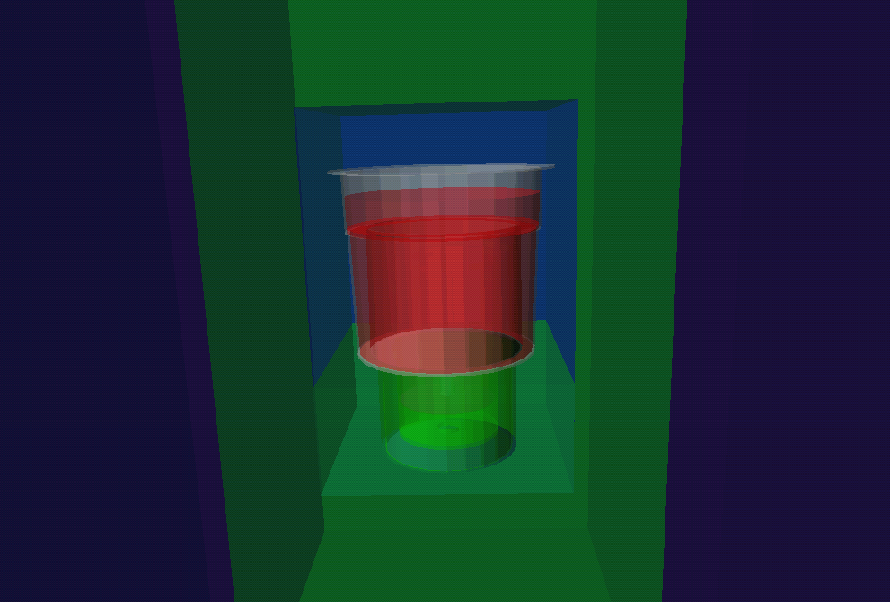
Gamma spectroscopy measurement
STELLA (SubTerranean Low Level Assay)
Sample 1 measured in polystyrene box
Samples in contact with detector
High Efficency
Samples 2 and 3 measured in polypropylene box (Marinelli)

Slide 19
Gamma spectroscopy measurement
⁴⁰K
Energy ~ 1460.8 keV
Detector | Sample | Rate [d⁻¹ g⁻¹] Before | Rate [d⁻¹ g⁻¹] After | reduction factor
GeCris | 1 | 2.820 ± 0.020 | 0.0230 ± 0.0015 | 0.9920 ± 0.0060
GeMi | 2 | 1.570 ± 0.010 | 0.112 ± 0.001 | 0.9290 ± 0.0120
GeMi | 3 | 1.570 ± 0.010 | 0.0350 ± 0.0012 | 0.9780 ± 0.0350
Reduction factor 120.5
Reduction factor 44.6
Reduction factor 13.9

Slide 20
Radionuclides measurement
Detector | Sample | Rate [d⁻¹ g⁻¹] Before | Rate [d⁻¹ g⁻¹] After | reduction factor
GeCris | 1 | 0.0170± 0.0020 | 0.0020 ± 0.007 | 0.87 ± 0.31
GeMi | 2 | 0.0090 ± 0.0010 | 0.0020 ± 0.004 | 0.81 ± 0.19
GeMi | 3 | 0.0090 ± 0.0010 | 0.0020 ± 0.004 | 0.86 ± 0.20
Determination of' ²³⁸U by
measuring ^{234m}Pa
Energy ~ 1001 keV
Detector | Sample | Rate [d⁻¹ g⁻¹] Before | Rate [d⁻¹ g⁻¹] After | reduction factor
GeCris | 1 | 0.0150 ± 0.0025 | 0.0030 ± 0.010 | 0.79 ± 0.33
GeMi | 2 | 0.0090 ± 0.0012 | 0.0030 ± 0.005 | 0.70 ± 0.16
GeMi | 3 | 0.0090 ± 0.0012 | 0.0020 ± 0.005 | 0.77 ± 0.22
Standard deviation depends on:
Density of sample
Composition
Geometry of detector
Determination of ²²⁸Ra by
Measuring ²²⁸Ac
Energy ~ 911 keV
Detector | Sample | Rate [d⁻¹ g⁻¹] Before | Rate [d⁻¹ g⁻¹] After | reduction factor
GeCris | 1 | 0.0330 ± 0.0020 | 0.0130 ± 0.005 | 0.61 ± 0.05
GeMi | 2 | 0.0200 ± 0.0010 | 0.0070 ± 0.003 | 0.66 ± 0.04
GeMi | 3 | 0.0200 ± 0.0010 | 0.0060 ± 0.002 | 0.71 ± 0.05
Direct determination of
²²⁶Ra
Energy ~ 186 keV
Detector | Sample | Rate [d⁻¹ g⁻¹] Before | Rate [d⁻¹ g⁻¹] After | reduction factor
GeCris | 1 | 0.0190 ± 0.0023 | 0.0030 ± 0.009 | 0.85 ± 0.29
GeMi | 2 | 0.0120 ± 0.0011 | 0.0020 ± 0.003 | 0.81± 0.14
GeMi | 3 | 0.0120 ± 0.0011 | 0.0010 ± 0.003 | 0.87 ± 0.17
Direct determination of
⁶⁰Co
Energy ~ 1173 keV
& 1332 keV

Slide 21
Gamma spectroscopy measurement
Measurement Problems
Cs⁺
Co-precipitation with K⁺;
I⁻
Is volatile;
²³²Th
Is sparingly soluble in water;
²¹⁰Pb
The emitted photon energy is low and the probability of emission is low;

Slide 22
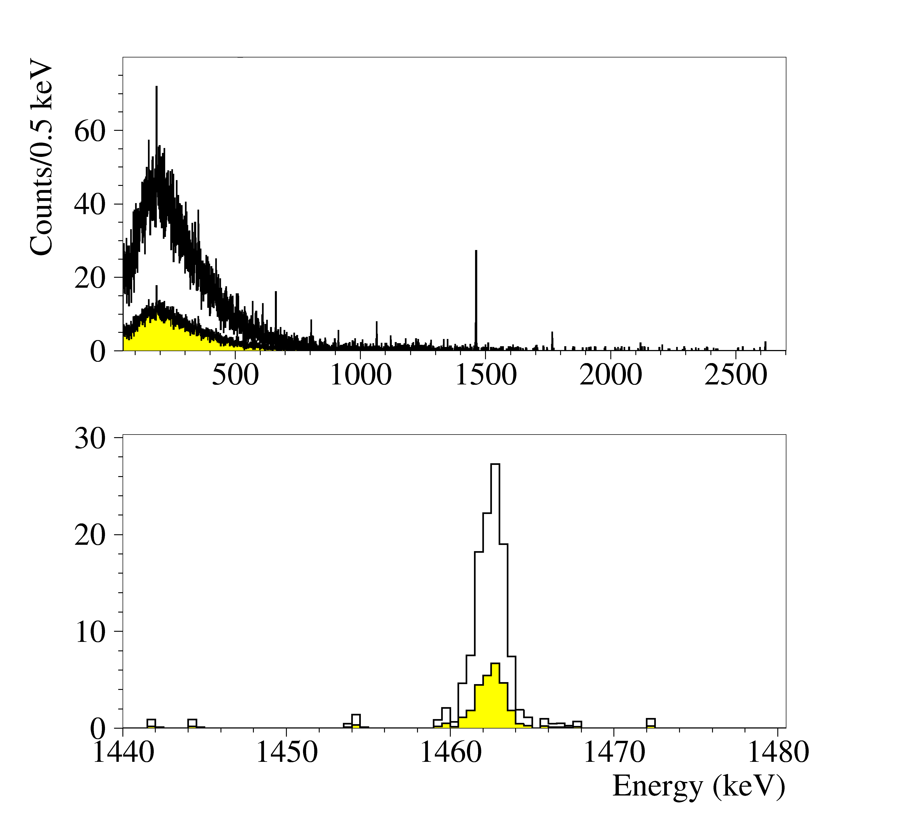
Conclusions
This work has shown that the selective precipitation of potassium with sodium tetraphenylborate is leading to an increase of sensitivity of radionuclides such as ²³⁸U,²²⁶Ra, ²²⁸Ra, ⁶⁰Co in γ-ray spectrometric analysis.
Improve by almost one order of magnitude
Reduction of ⁴⁰K

Slide 23
Conclusions
Comparison between γ-ray spectroscopy and ICP-MS measurement
Sample | Technique | % K
1 | γ-ray spectroscopy | 99.2
 | ICP-MS | 99.8
2 | γ-ray spectroscopy | 92.9
 | ICP-MS | 92.4
3 | γ-ray spectroscopy | 97.8
 | ICP-MS | 96.3

Slide 24
Conclusions
    Eliminate high percentages of Potassium is rather inexpensive;
    Improvement of sensitivity for radionuclides;
    Compare ICP-MS and γ -ray spectroscopy;
Future development:
    Investigation of the possibility to apply this method to different kind of matrices;
    Recovery of reagents for a further reduction of the costs;

Slide 25
Acknowledgements
Dr. Matthias Laubenstein
Ing. Stefano Nisi
Prof. Francesco De Angelis

Slide 26
Thank you for your attention !

